Slide 1




A WORLD OF
DIFFERENCE
Recognising and challenging stereotypes of visible difference
Secondary Lesson ©Changing Faces 2021
1

Slide 2
CLASS
DISCUSSION
What does the word stereotype mean?

Slide 3
A stereotype is an idea about a particular group
of people that is often oversimplified, untrue or unfair.

Slide 4
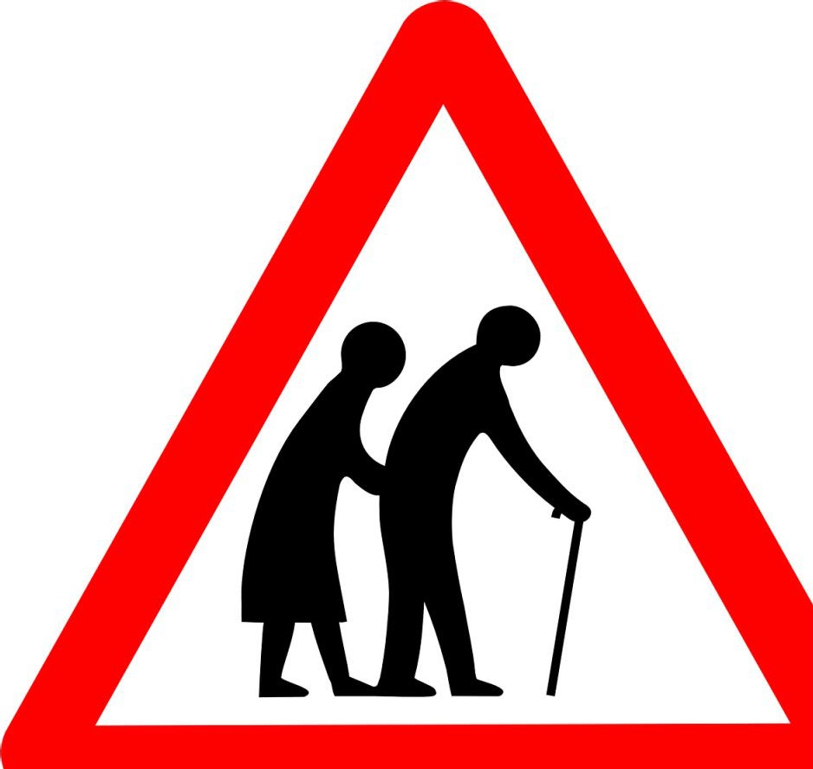

Slide 5

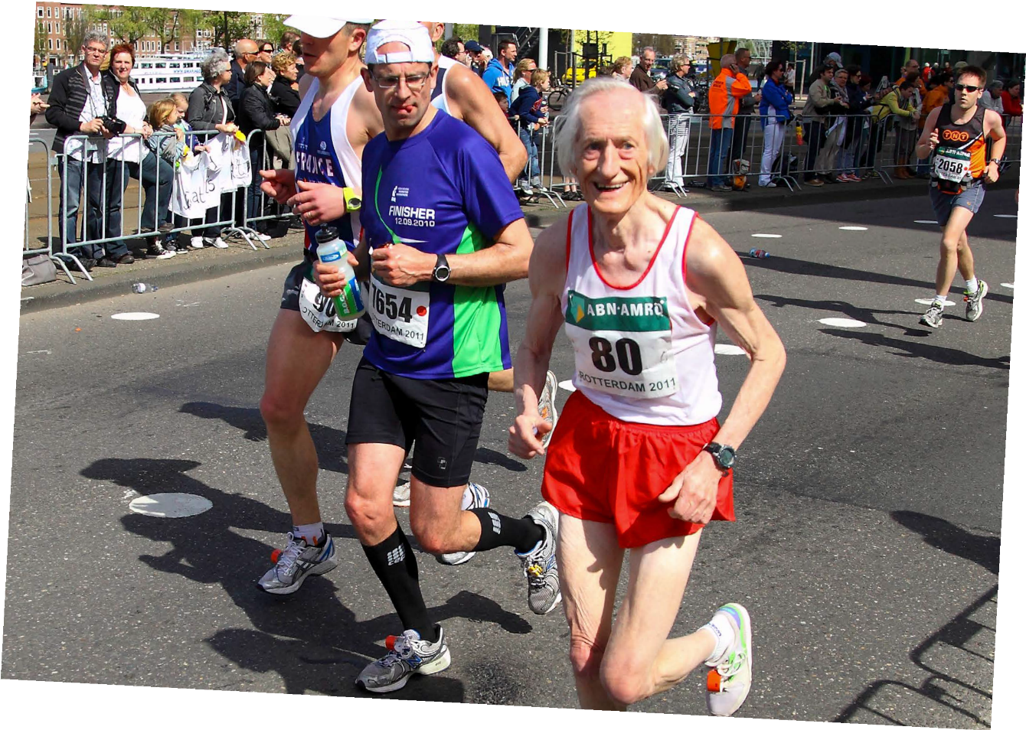
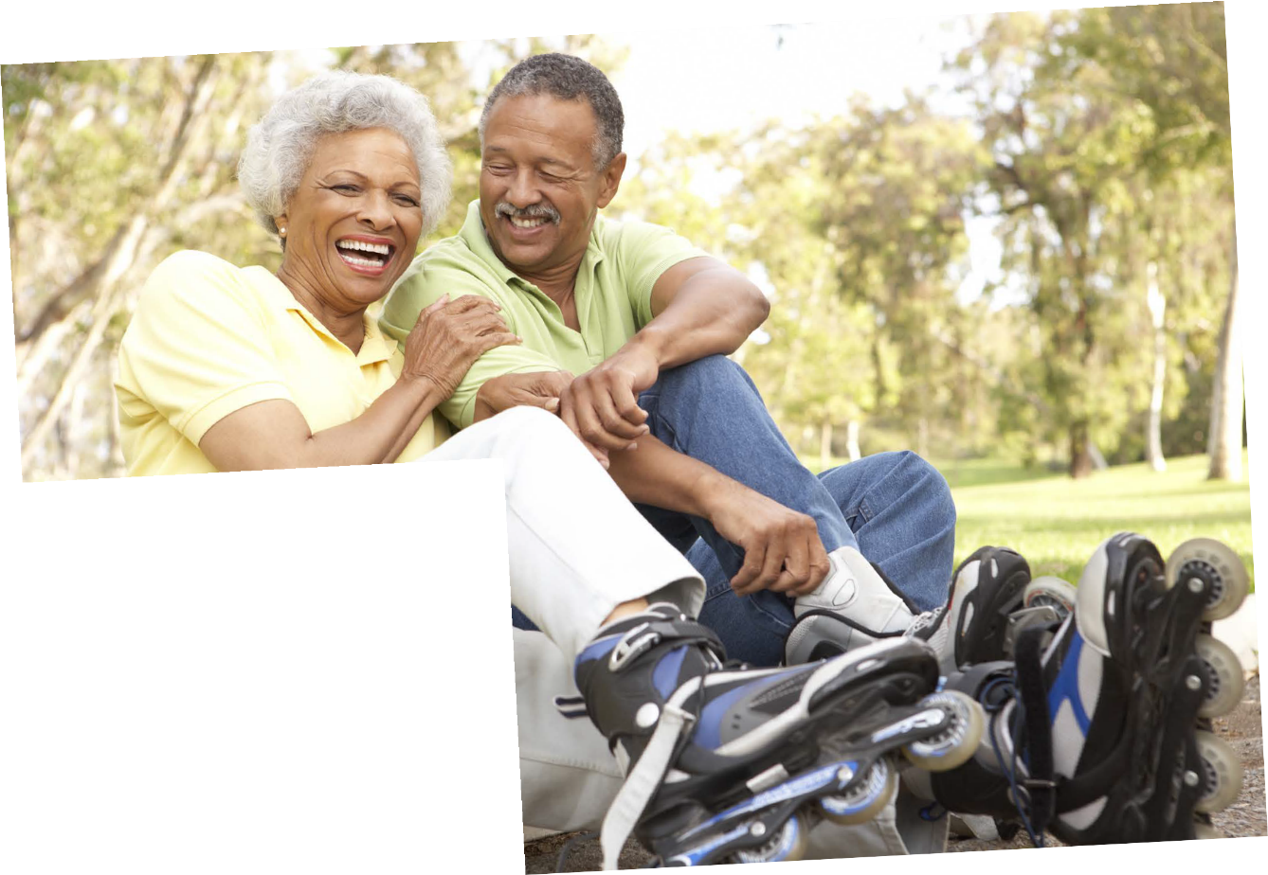
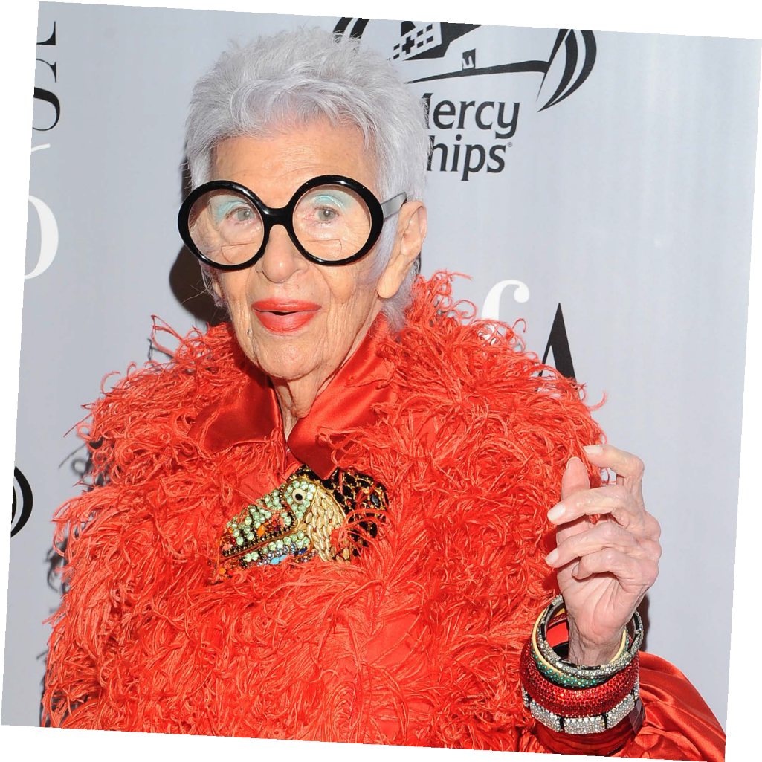
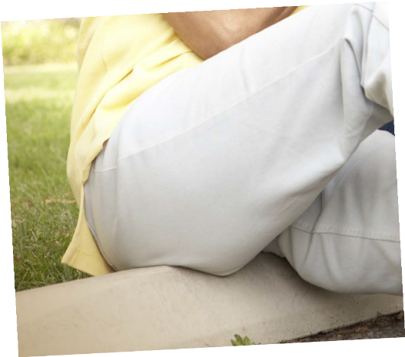

Credit: Repelsteeltje/Shutterstock.com
Credit: Shutterstock
Credit: Shutterstock
Credit: Ron Adar/Shutterstock.com

Slide 6
CLASS
DISCUSSION
What impact do stereotypes have?

Slide 7
Today we’re going to be talking about how stereotypes
affect people who have a visible difference
(a mark, scar or condition that affects how they look).

Slide 8
Causes of a visible difference:
Skin conditions like eczema, acne, or vitiligo
Burns
Birthmarks
Craniofacial conditions, affecting the growth and development of the skull and face
Cleft lip/palate (a gap or split in the upper lip and/or roof of the mouth)
Cancer

Slide 9
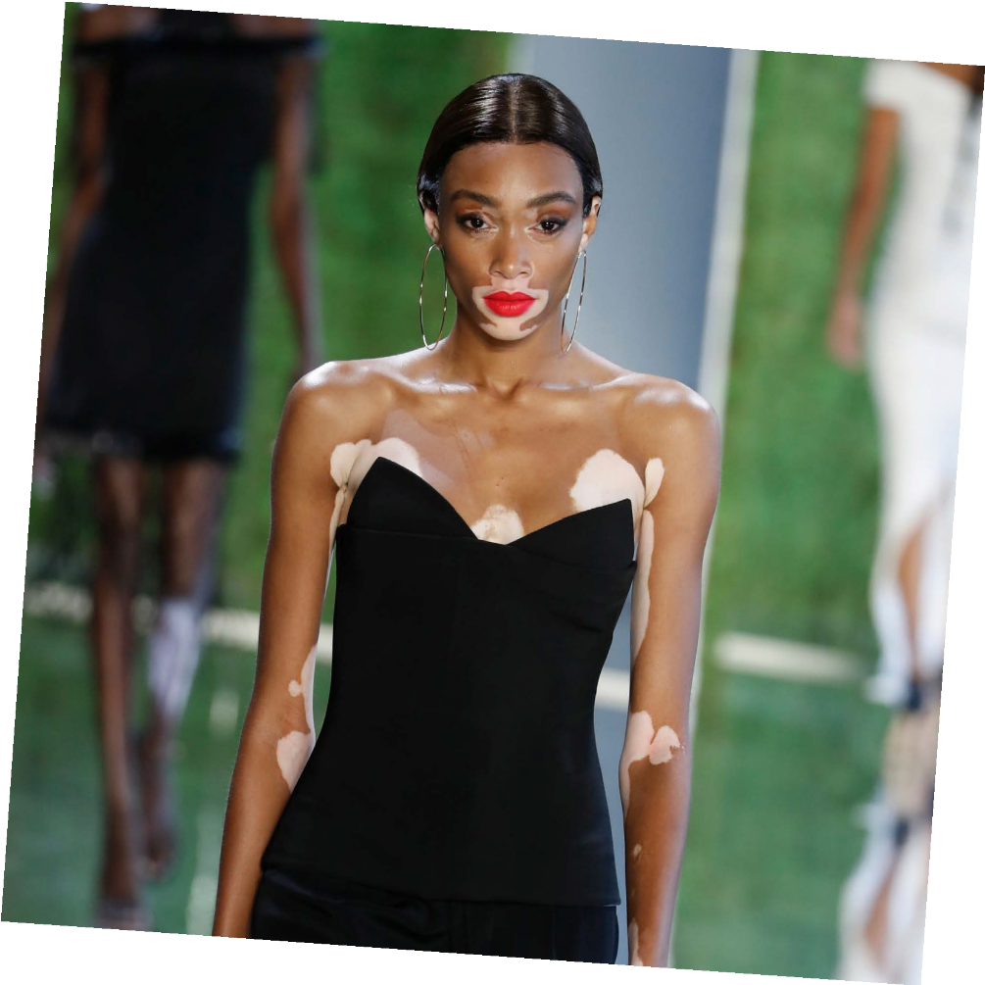
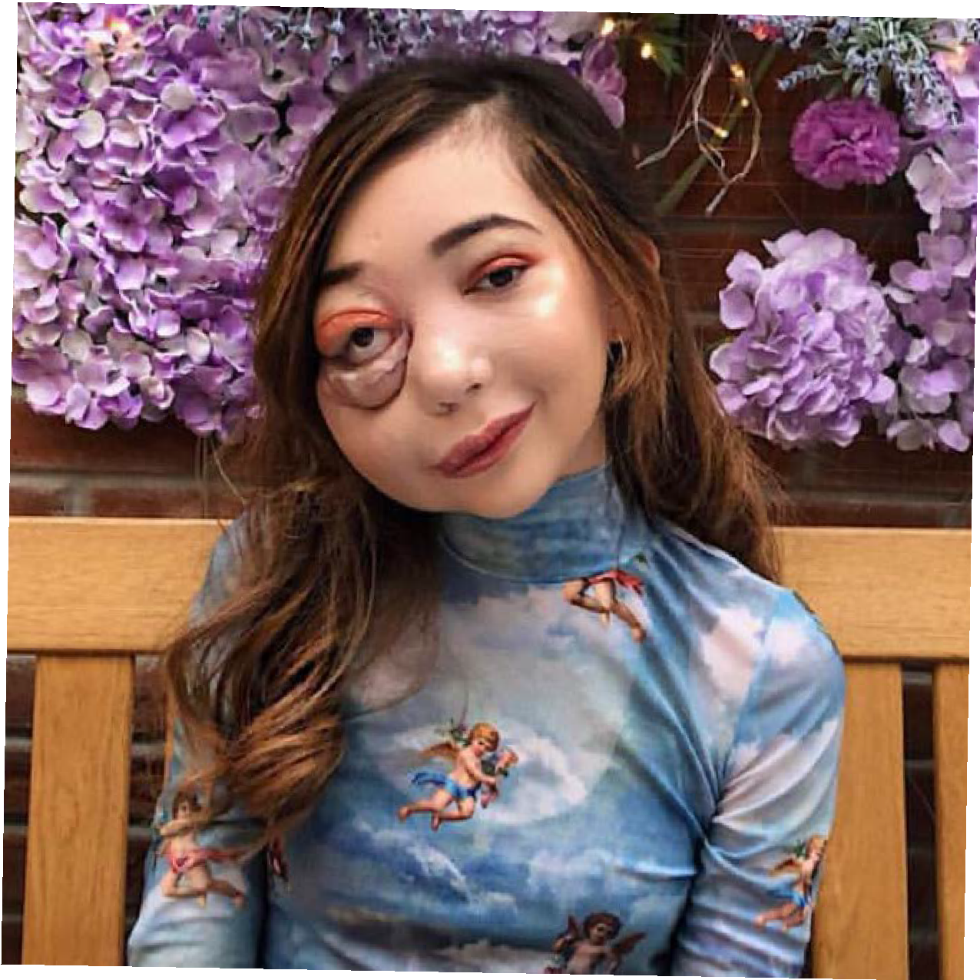
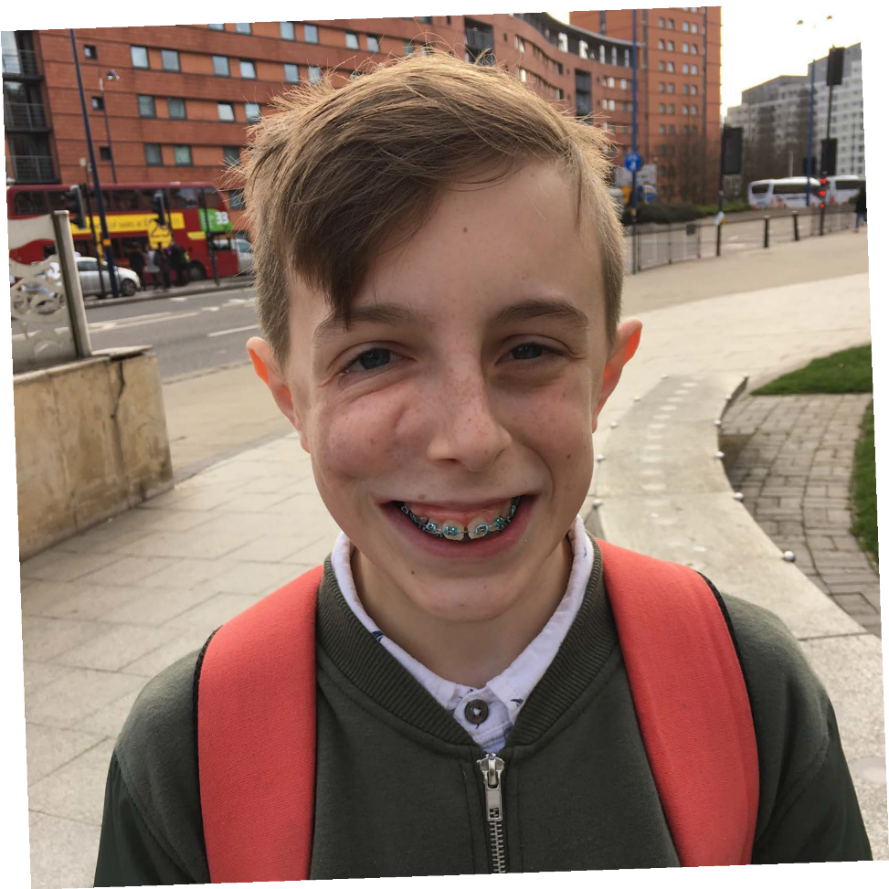
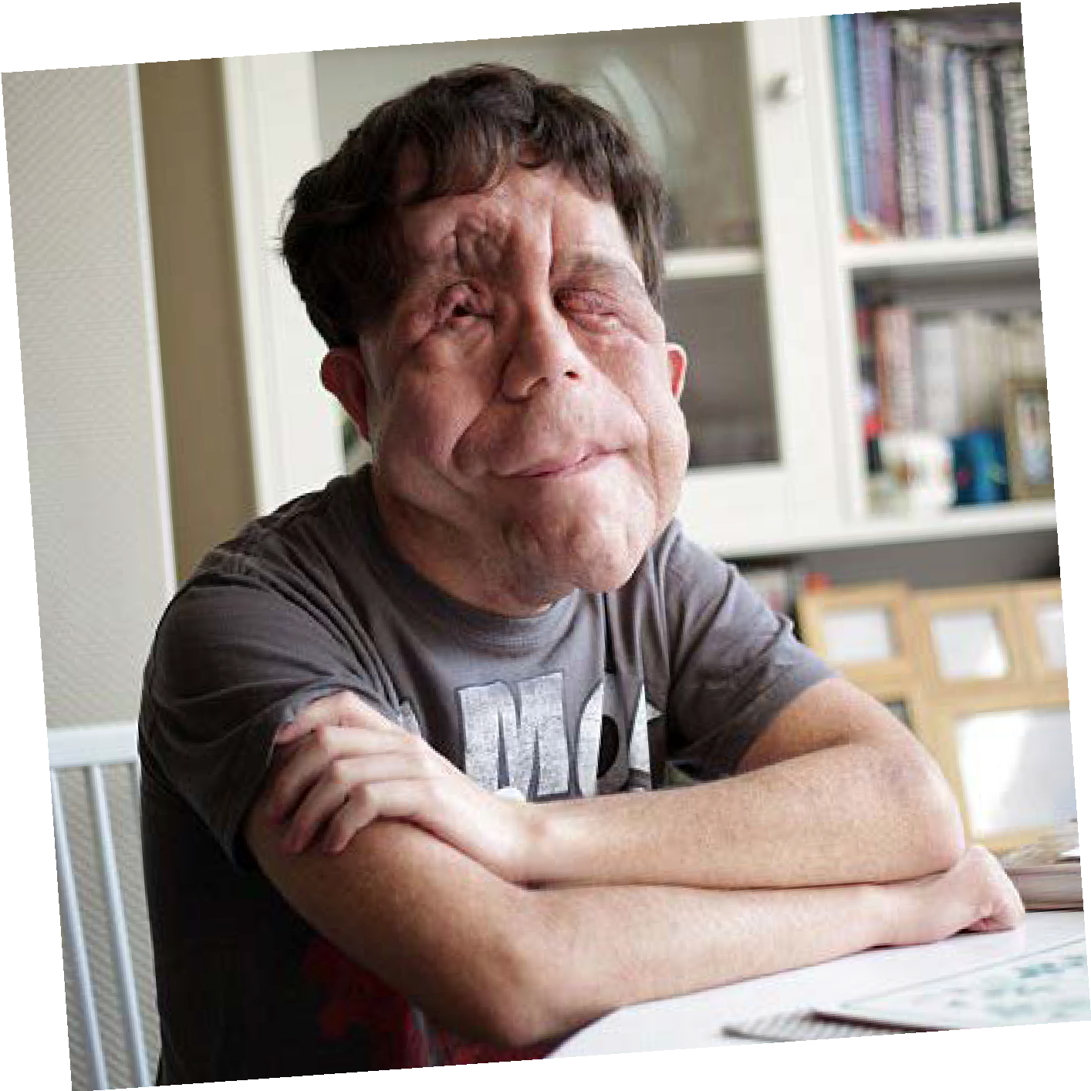
There are many types of visible diference
Credit: FashionStock.c^{om/Shutterstock.com}

Slide 10
GROUP
ACTIVITY
Write a list of film or TV characters who have a scar, mark or condition that affects their appearance.

Slide 11
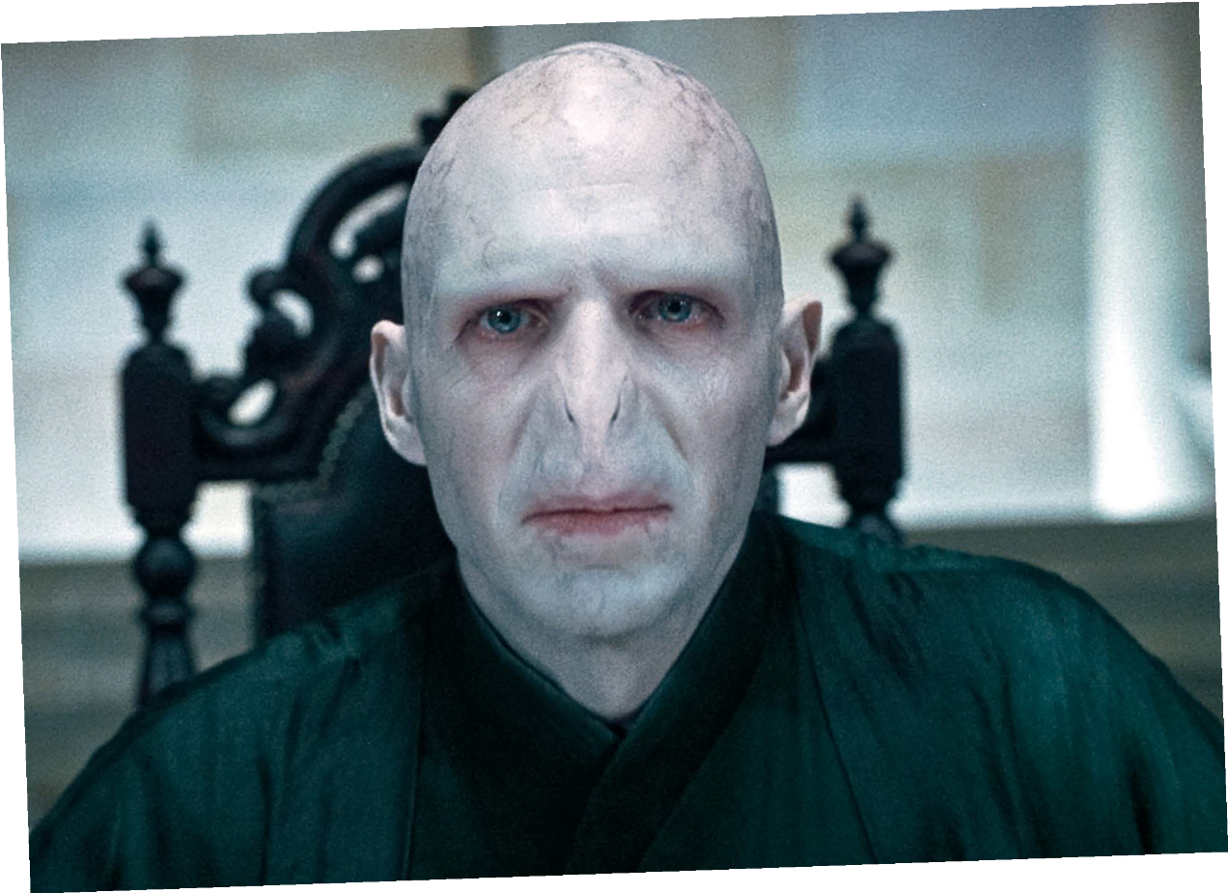
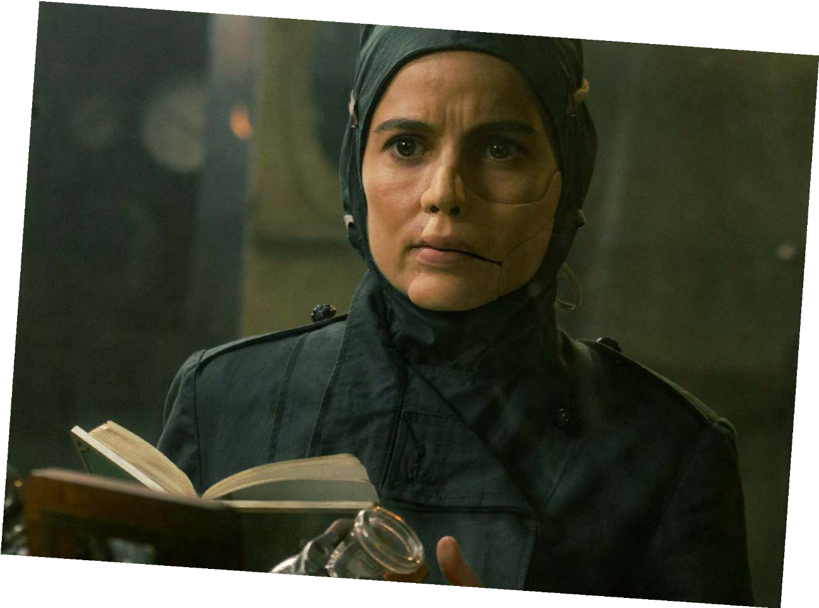
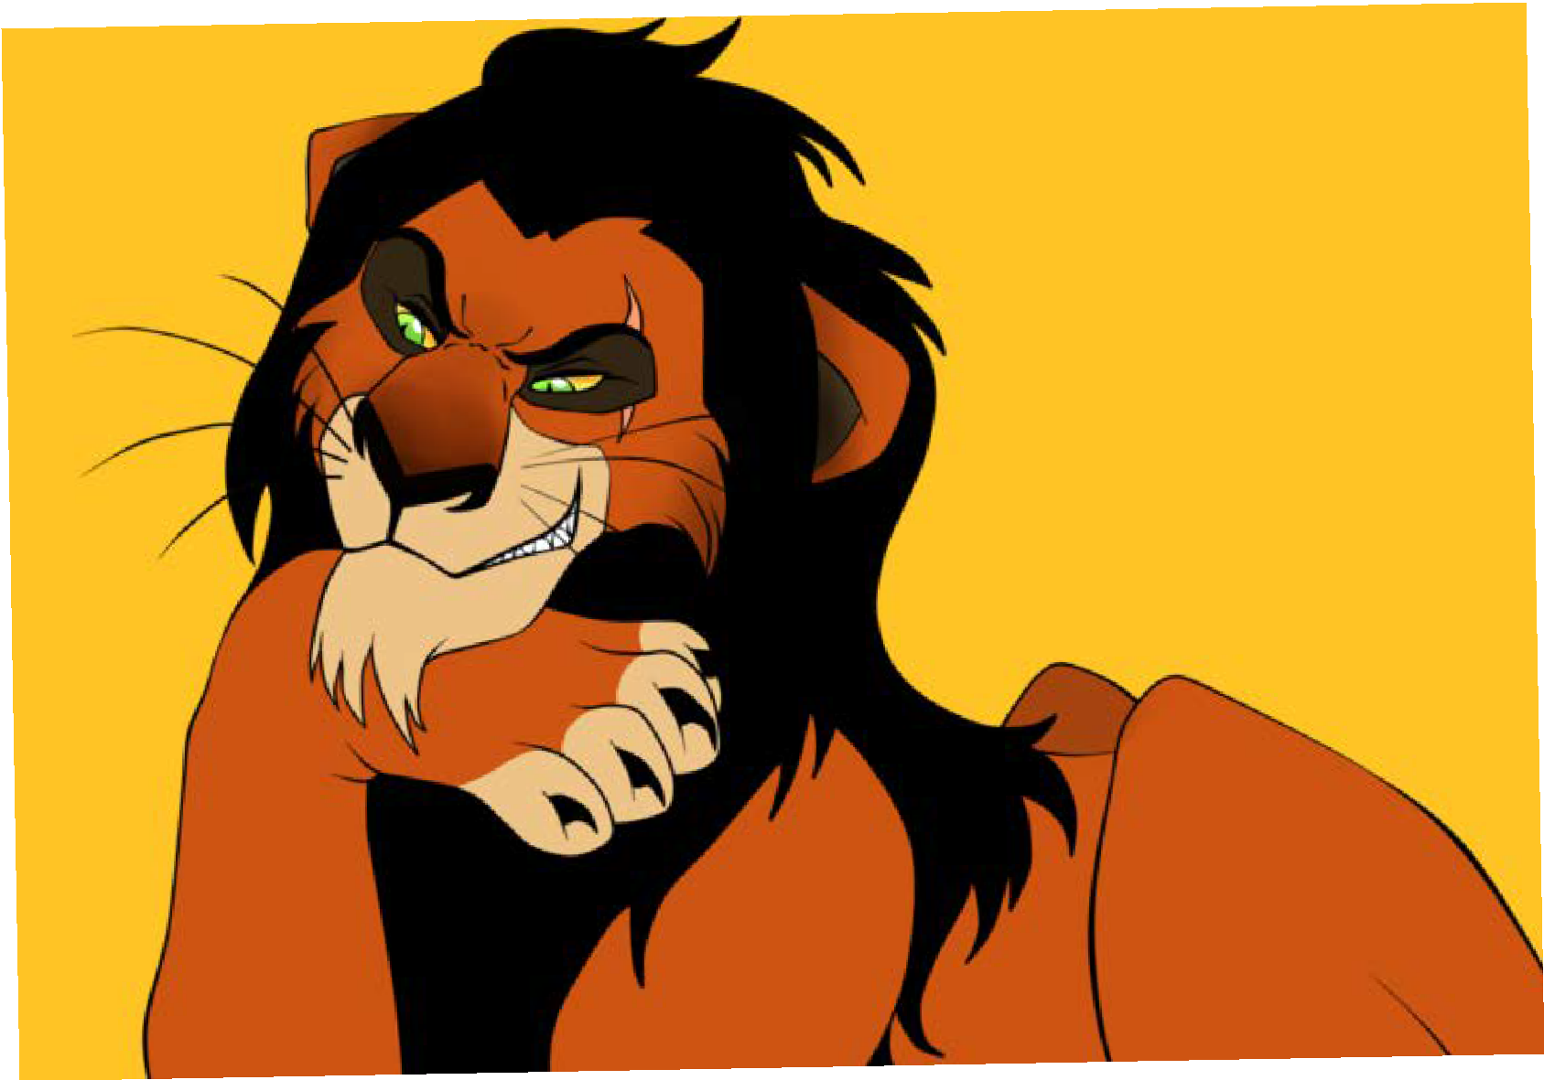
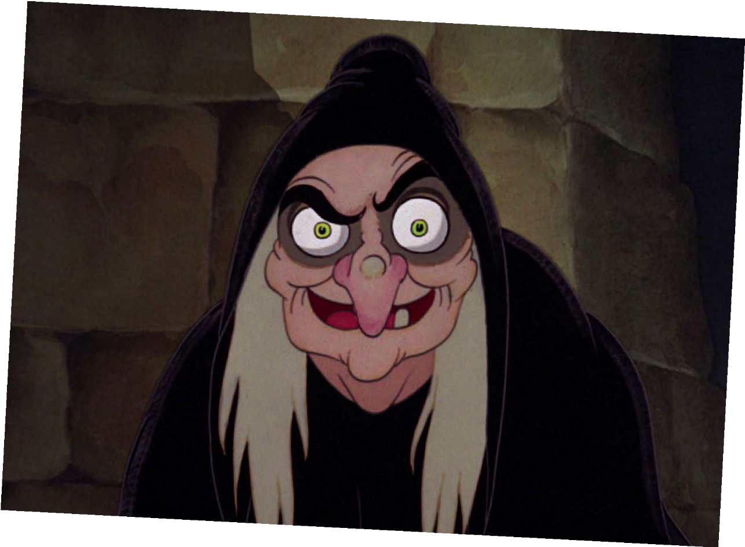




Voldemort
HARRY POTTER
and Ratpac-Dune Entertainment LLC
©Warner Bros. Entertainment Inc.
©Warner Bros. Entertainment Inc.
Dr Poison
WONDER WOMAN
©Disney
Scar
THE LION KING
©Disney
The Evil Queen
SNOW WHITE

Slide 12
CLASS
DISCUSSION
What impact could stereotypical film and TV villains have on people who have a visible difference in real life?

Slide 13
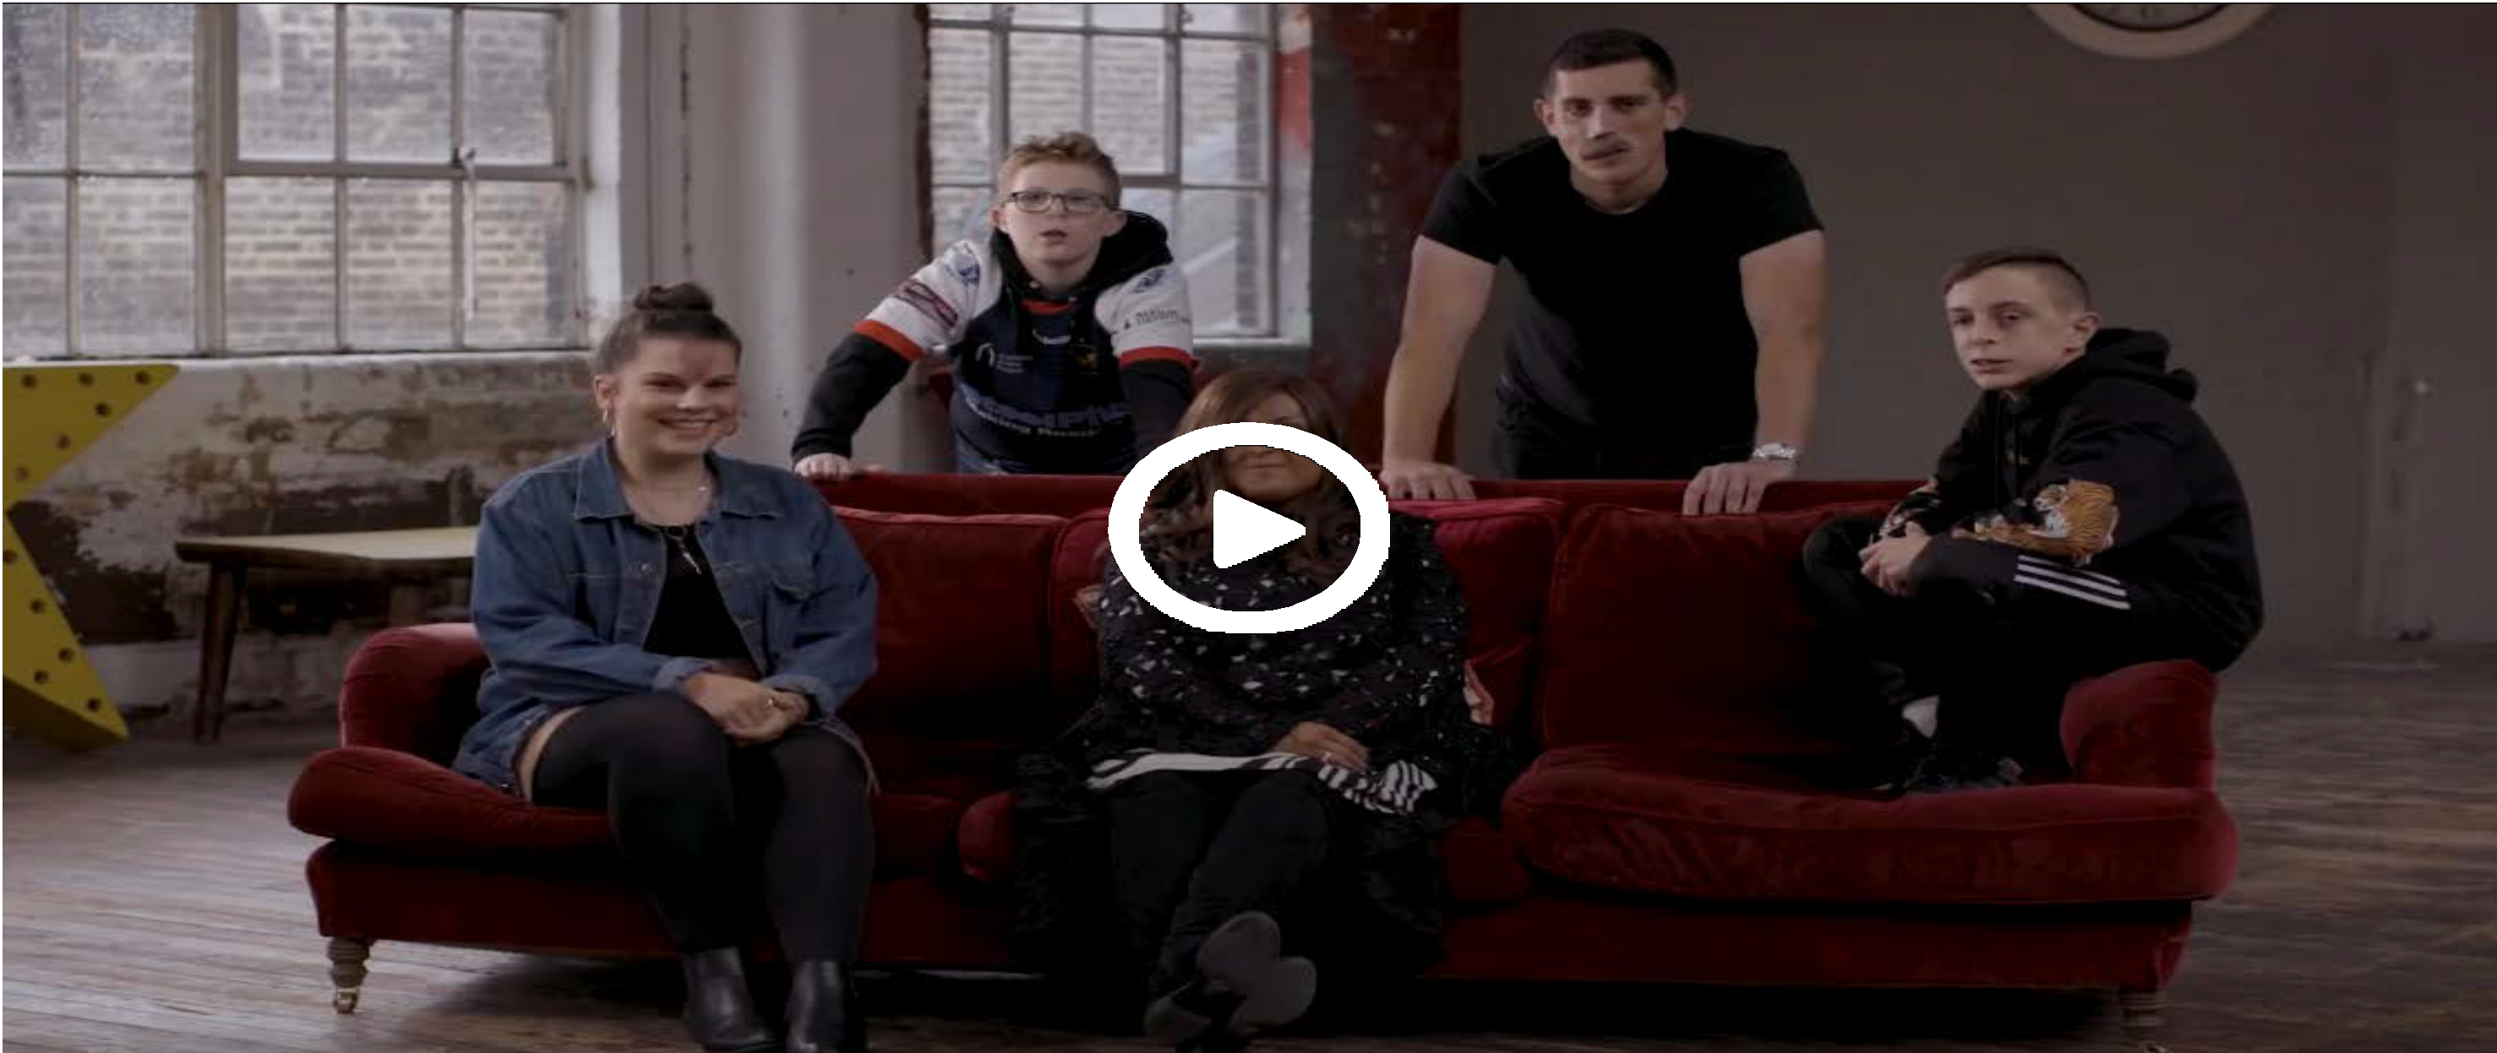


#iamnotyourvillain
For the video to work, please make sure you are in slideshow mode.

Slide 14
Other helpful
websites:
youngminds.org.uk
Find out more about visible differences and respecting difference: changingfaces.org.uk
Worried about anything we’ve discussed?
You can contact Childline for help:
childline.org.uk
respectme.org.uk

