Slide 1




A WORLD OF
DIFFERENCE
Recognising and challenging stereotypes of visible difference
Secondary Assembly ©Changing Faces 2021
1

Slide 2
QUESTION
TIME
What do these statements have in common?

Slide 3
All teenagers take drugs and commit crime
All women are bad drivers
Pensioners are too old to enjoy life anymore
Men are not very good at looking after children

Slide 4
They are all stereotypes.
A stereotype is an idea about a particular group of people that is often untrue or unfair.

Slide 5
QUESTION
TIME
What makes a film or TV villain scary?

Slide 6
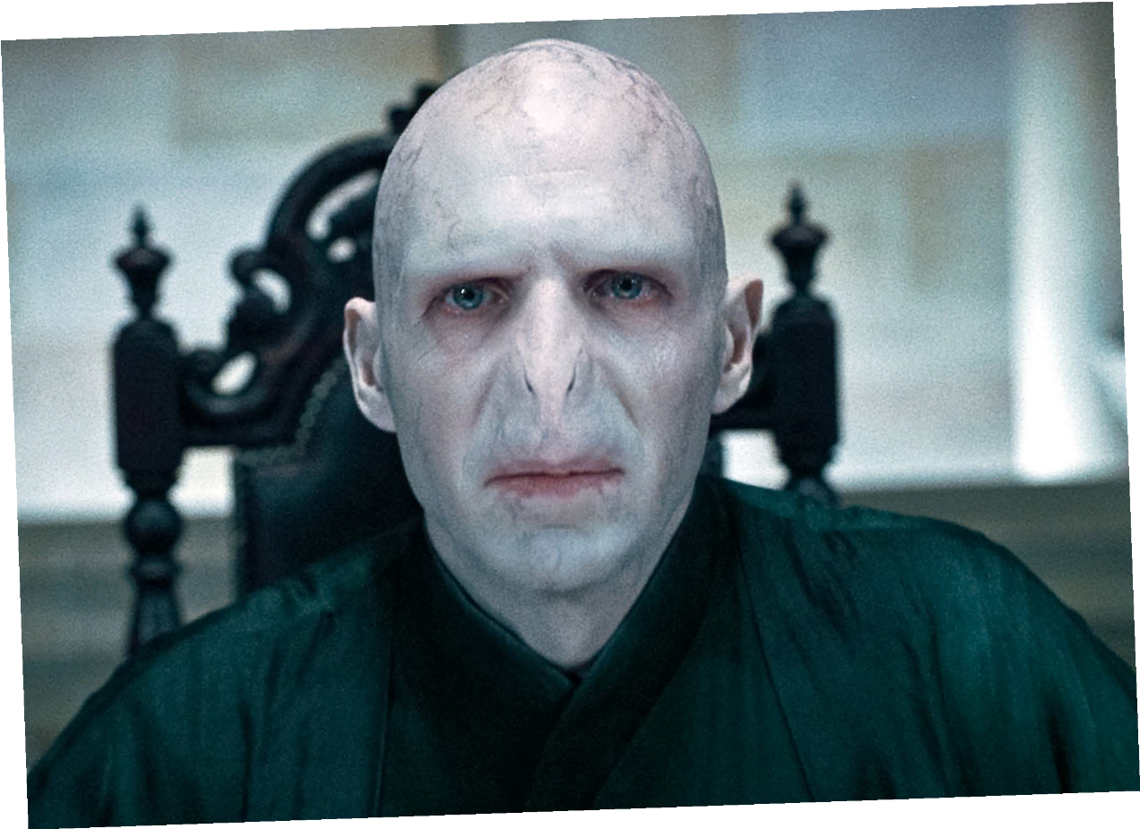
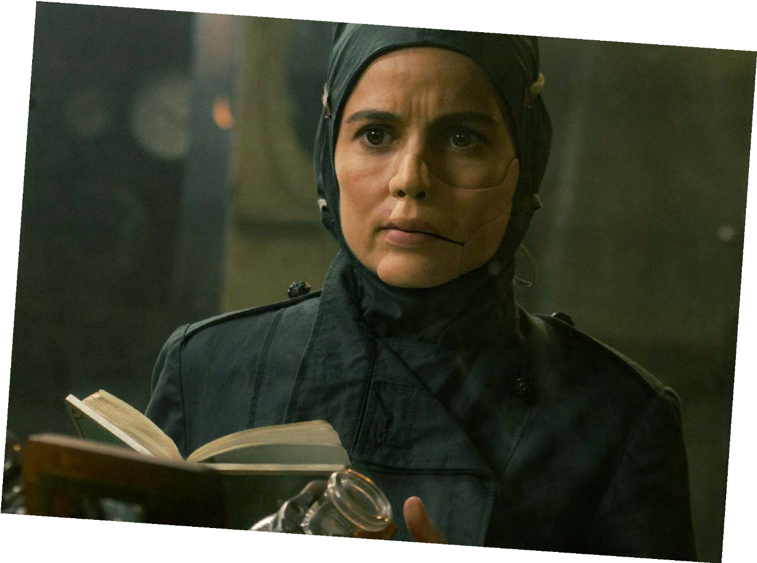
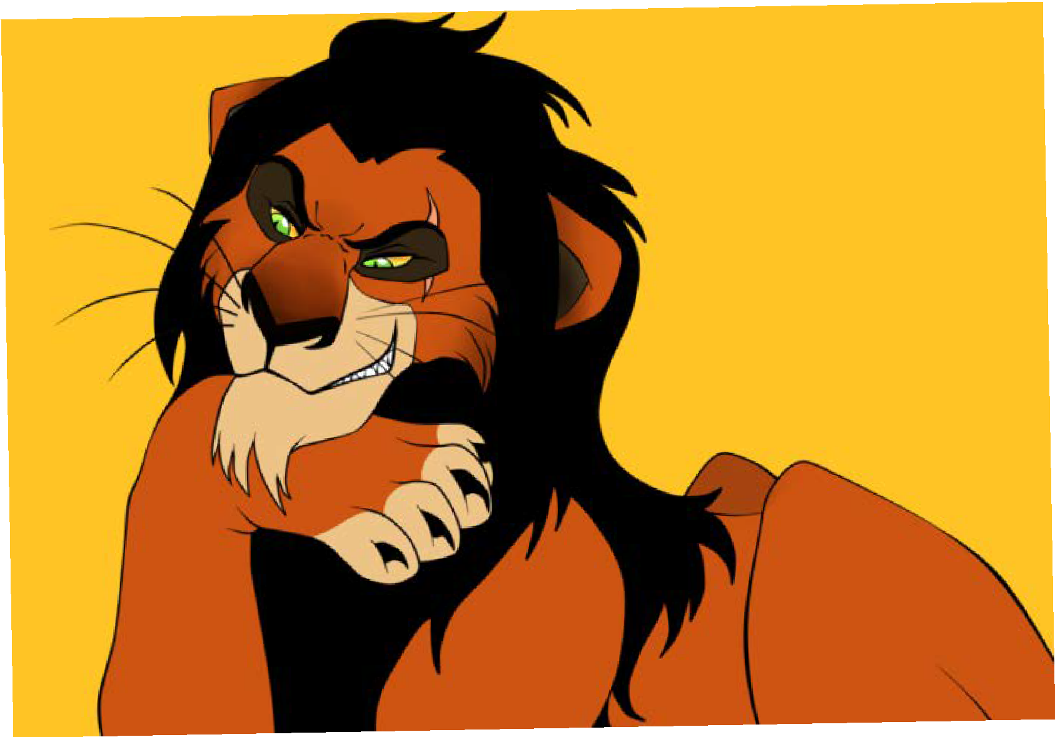
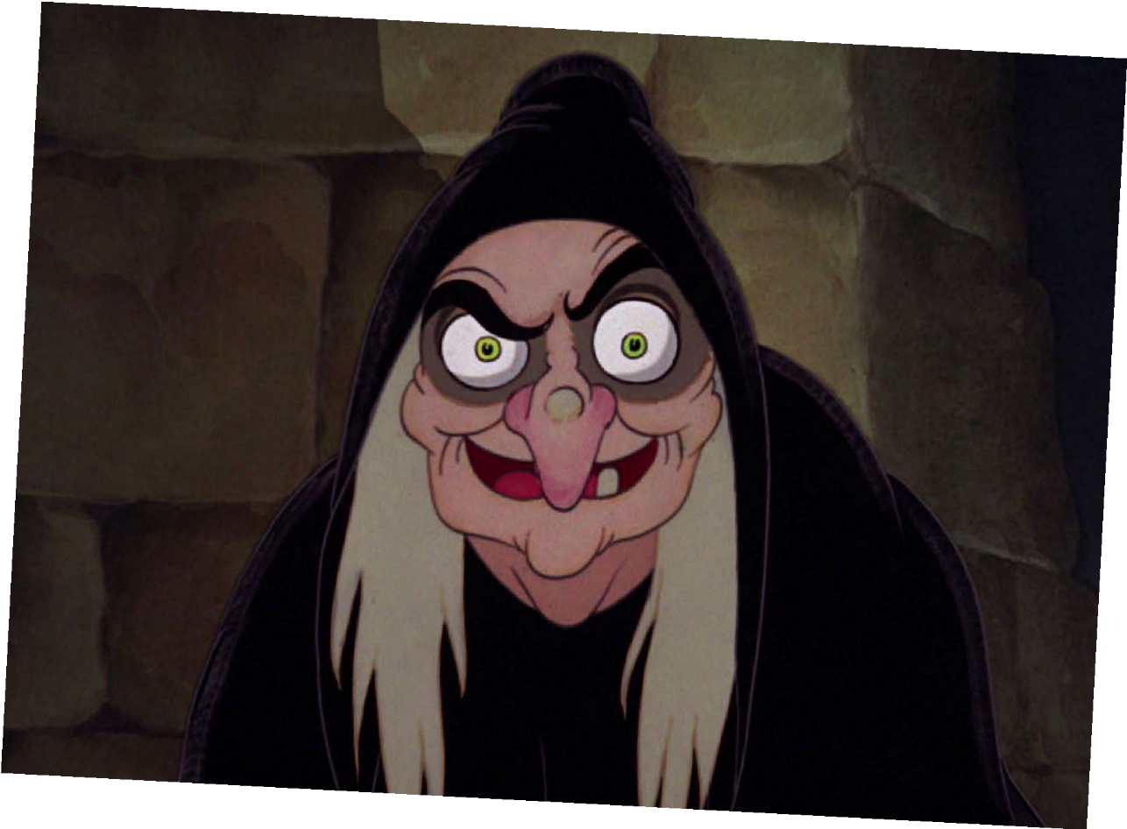
Voldemort
HARRY POTTER
and Ratpac-Dune Entertainment LLC
©Warner Bros. Entertainment Inc.
©Warner Bros. Entertainment Inc.
Dr Poison
WONDER WOMAN
©Disney
Scar
THE LION KING
©Disney
The Evil Queen
SNOW WHITE

Slide 7
All of the villains on the previous slide have an unusual appearance, such as a scar.
How many heroes can you think of who have a scar, mark or condition that affects their appearance?

Slide 8
It’s common for films and TV programmes to use the stereotype that if you look different,
you must be a villain.
This has a negative impact on people who look different in real life.

Slide 9
A visible difference is a mark, scar or condition that affects the appearance
of someone’s face or body.

Slide 10
Causes of a visible difference:
Skin conditions like eczema, acne, or vitiligo
Burns
Birthmarks
Craniofacial conditions, affecting the growth and development of the skull and face
Cleft lip/palate (a gap or split in the upper lip and/or roof of the mouth)
Cancer

Slide 11
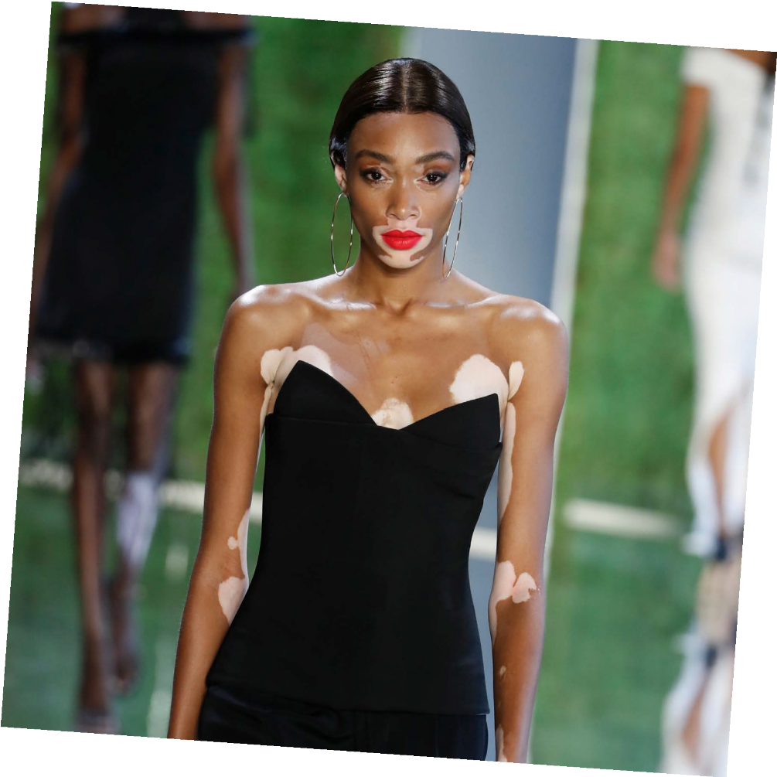
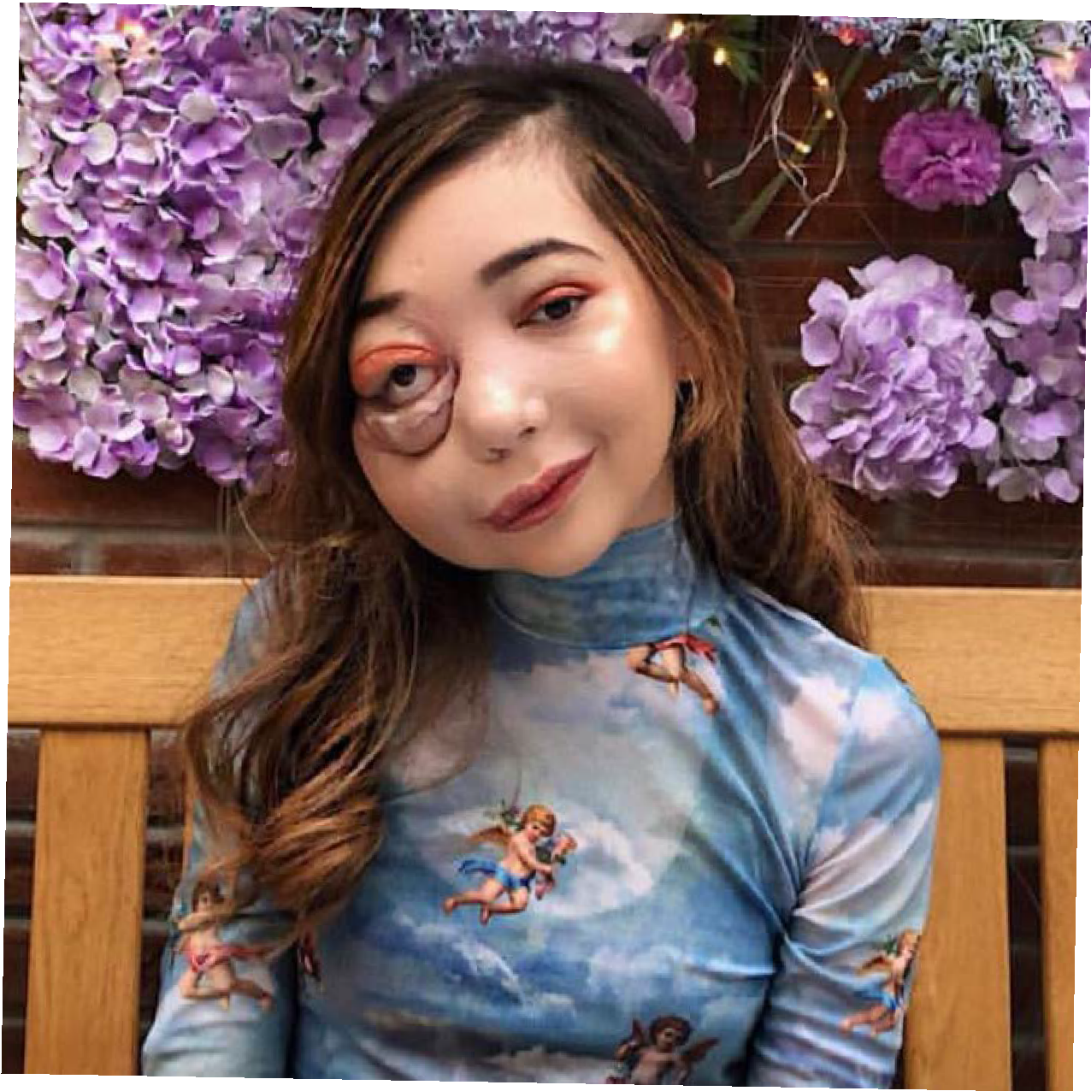
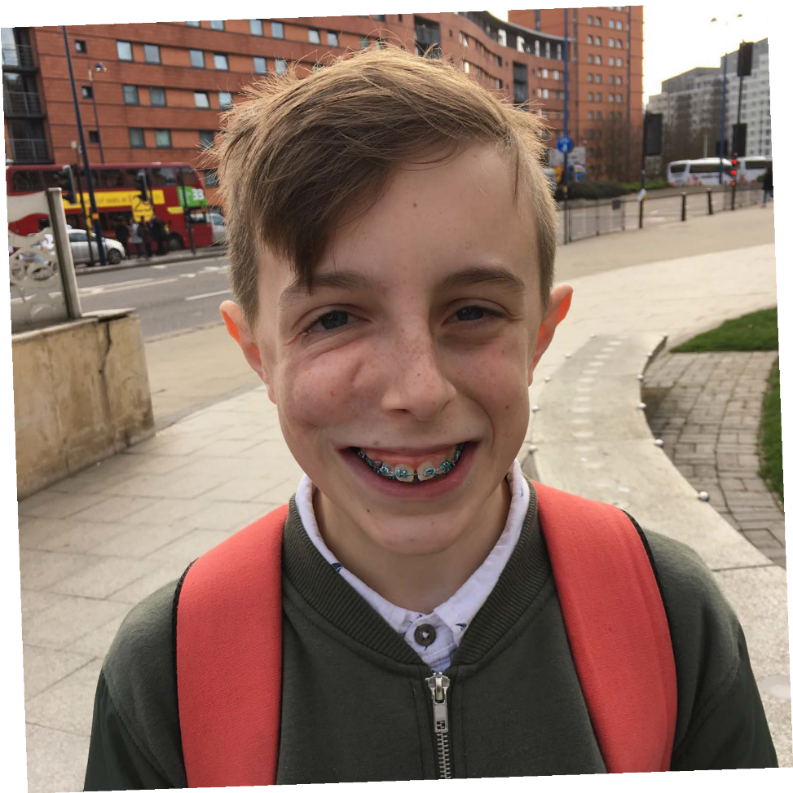
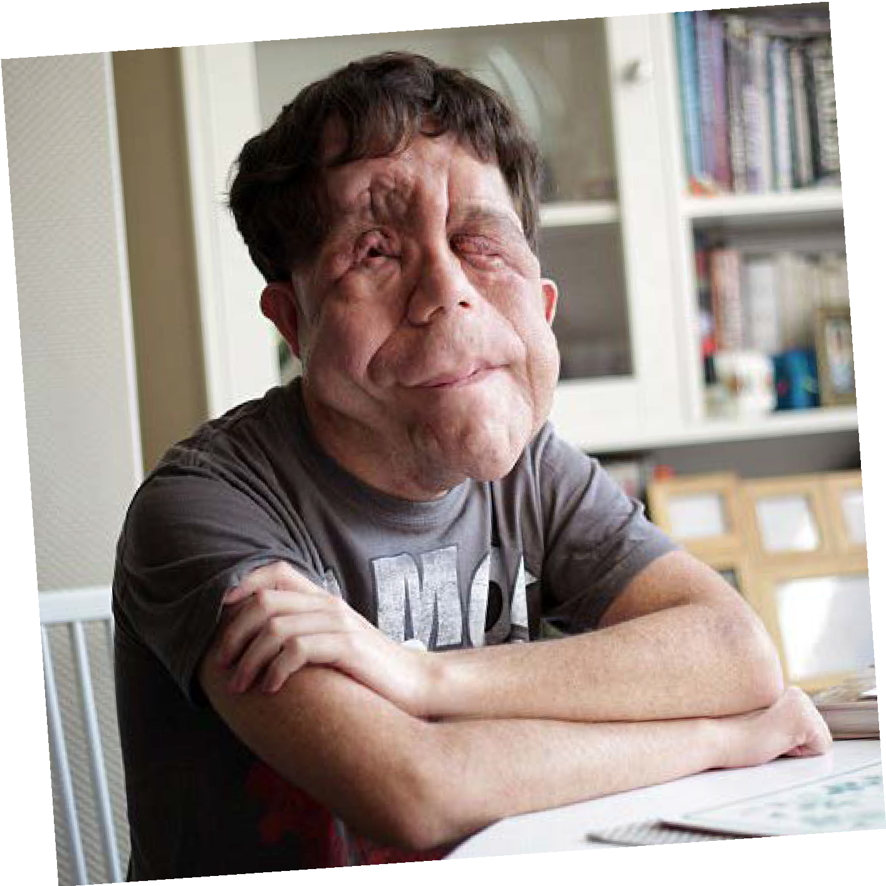
There are many types of visible diference
Credit: FashionStock.c^{om/Shutterstock.com}

Slide 12
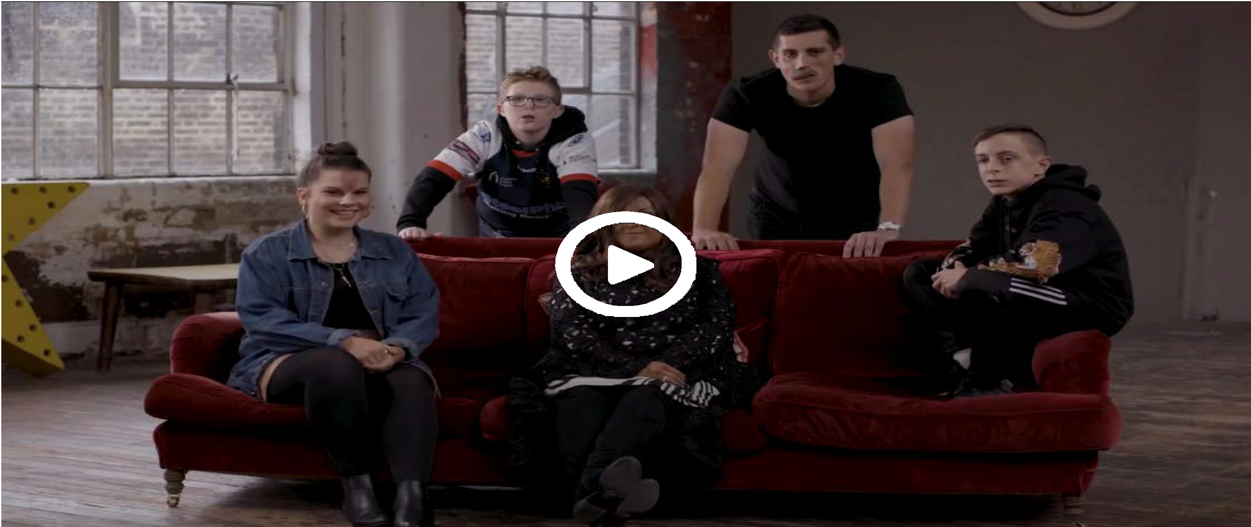
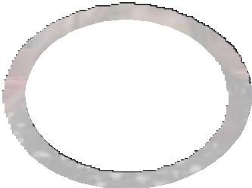

#iamnotyourvillain
For the video to work, please make sure you are in slideshow mode.

Slide 13
Other helpful
websites:
youngminds.org.uk
Find out more about visible differences and respecting difference: changingfaces.org.uk
Worried about anything we’ve discussed?
You can contact Childline for help:
childline.org.uk
respectme.org.uk

