Slide 1




A WORLD OF
DIFFERENCE
Recognising and challenging stereotypes of visible difference
PRIMARY LESSON ONE
Primary Lesson One ©Changing Faces 2021
1

Slide 2
What does a ‘baddie’ from a film look like?
Think about the ‘baddies’ you’ve seen in films and on TV and draw a picture of one of them.

Slide 3
CLASS
DISCUSSION
What does the word stereotype mean?

Slide 4
A stereotype is an idea about a particular group of people that is often untrue or unfair.

Slide 5


Slide 6
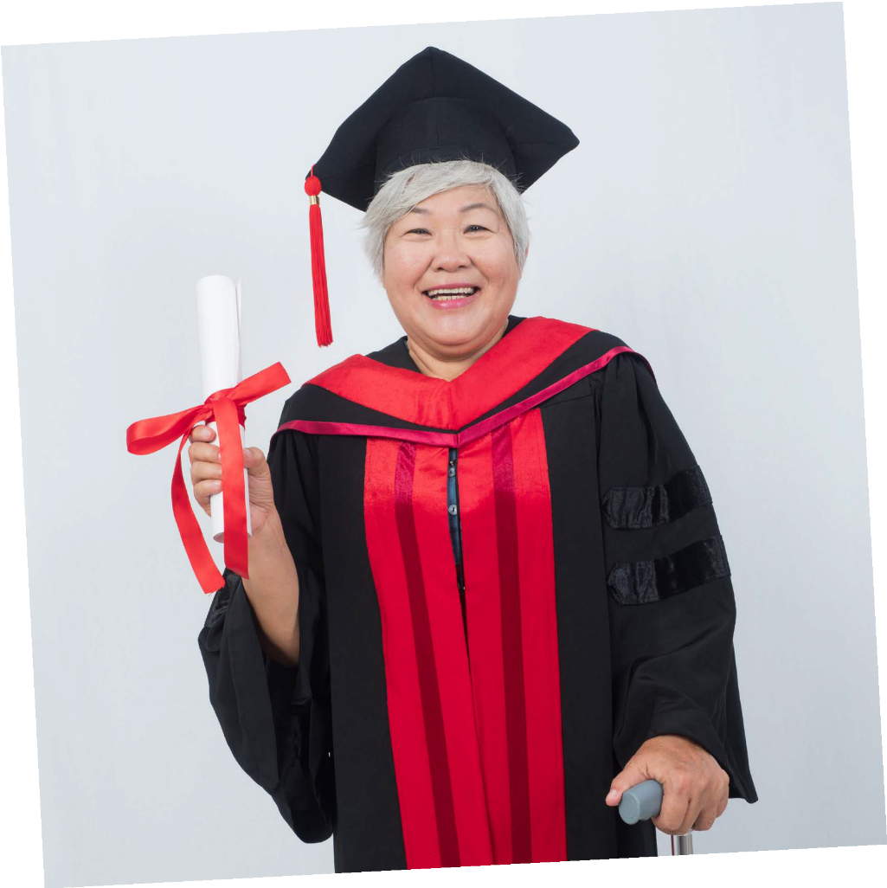
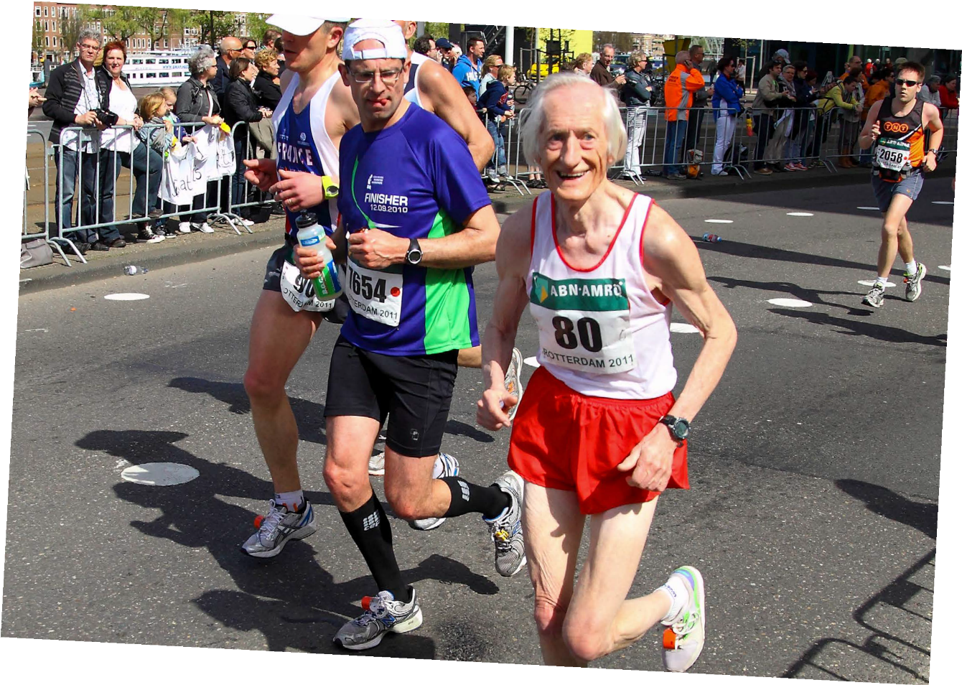
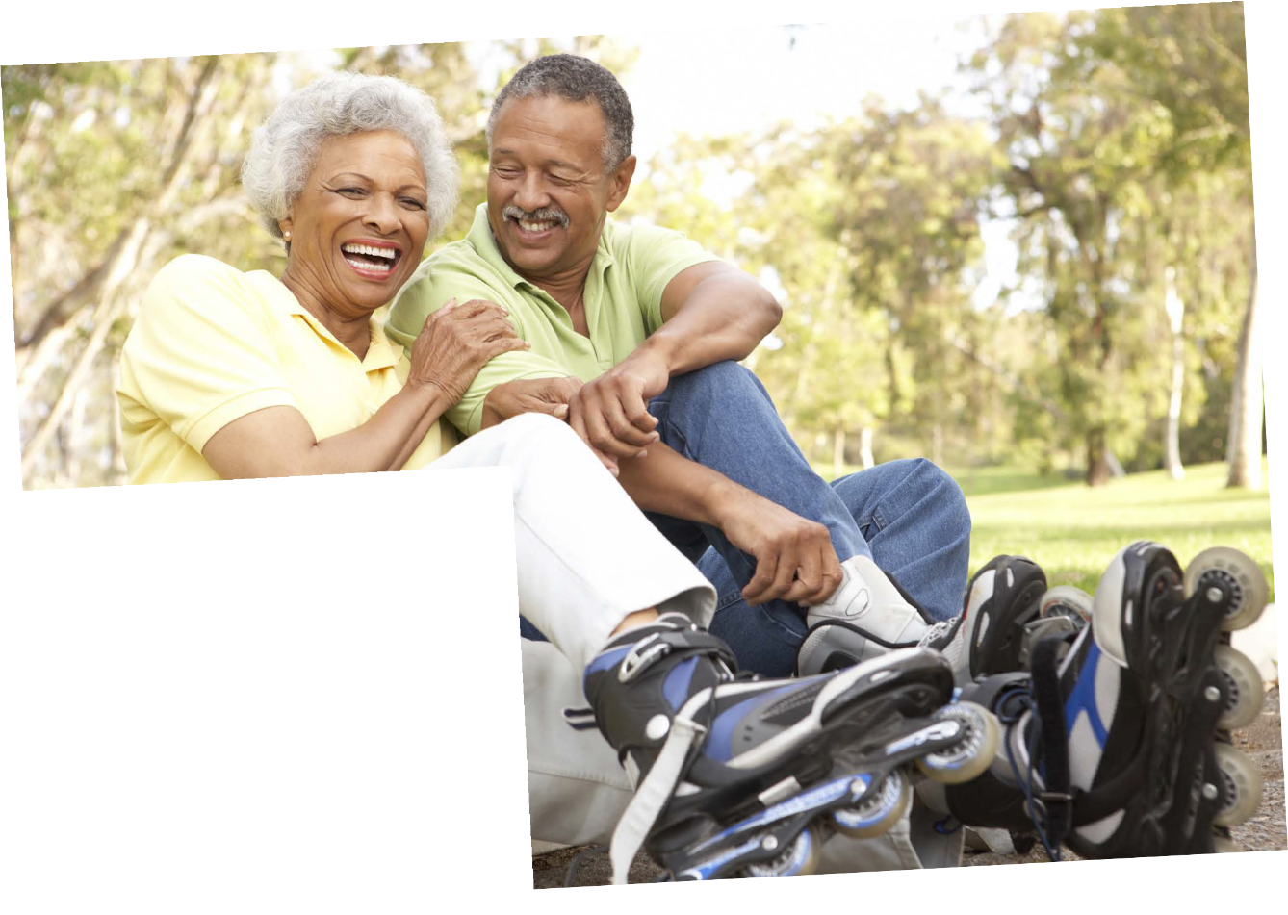
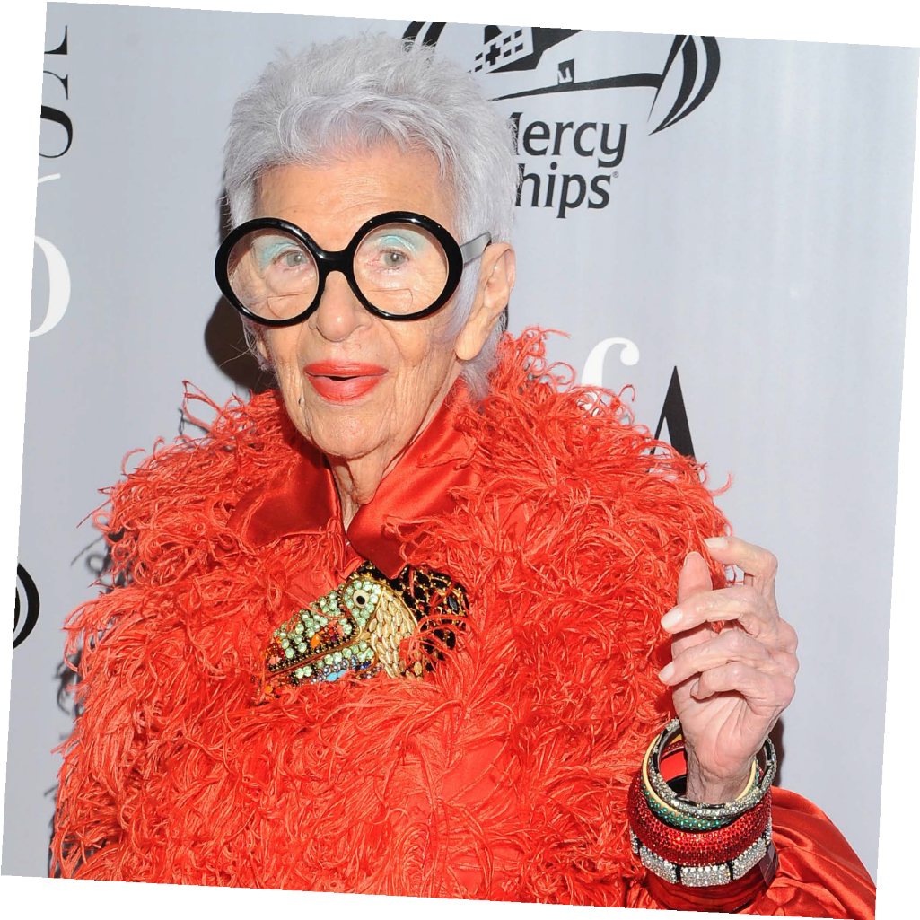
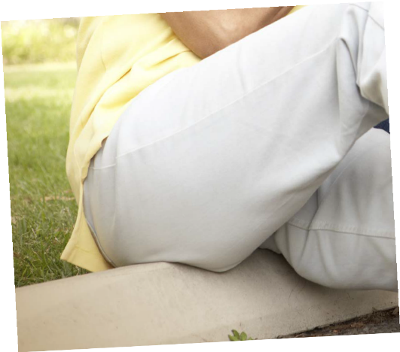
Credit: Repelsteeltje/Shutterstock.com
Credit: Shutterstock
Credit: Shutterstock
Credit: Ron Adar/Shutterstock.com

Slide 7
Today we’re going to be talking about how stereotypes
affect people who have a visible difference
(a mark, scar or condition that affects how they look).

Slide 8
Causes of a visible difference:
Skin conditions like eczema, acne, or vitiligo
Burns
Birthmarks
Craniofacial conditions, affecting the growth and development of the skull and face
Cleft lip/palate (a gap or split in the upper lip and/or roof of the mouth)
Cancer

Slide 9
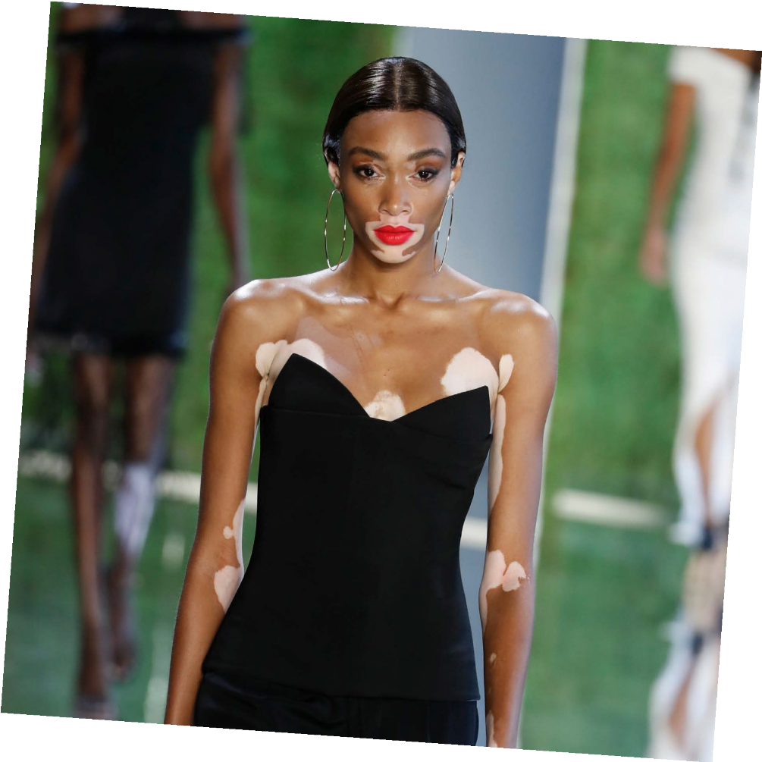
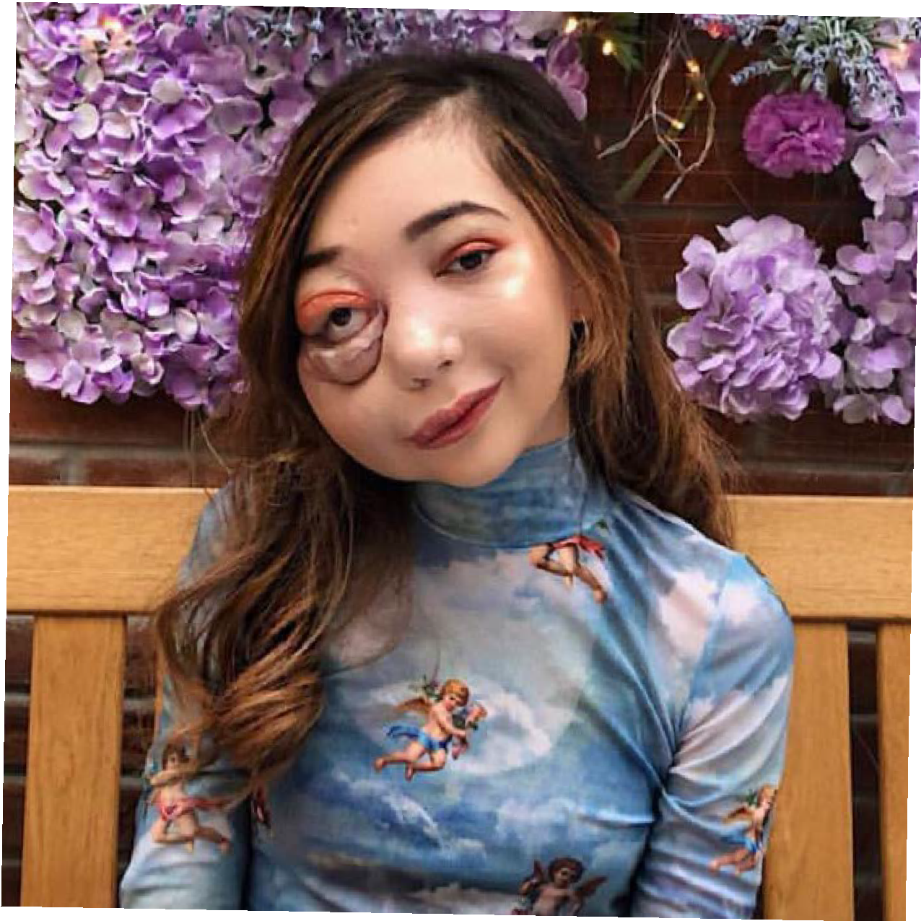
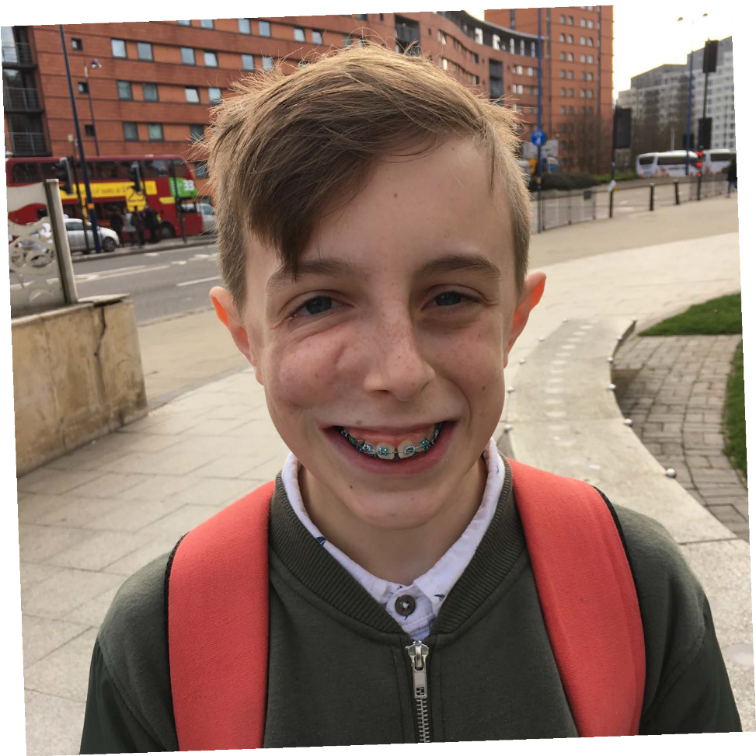
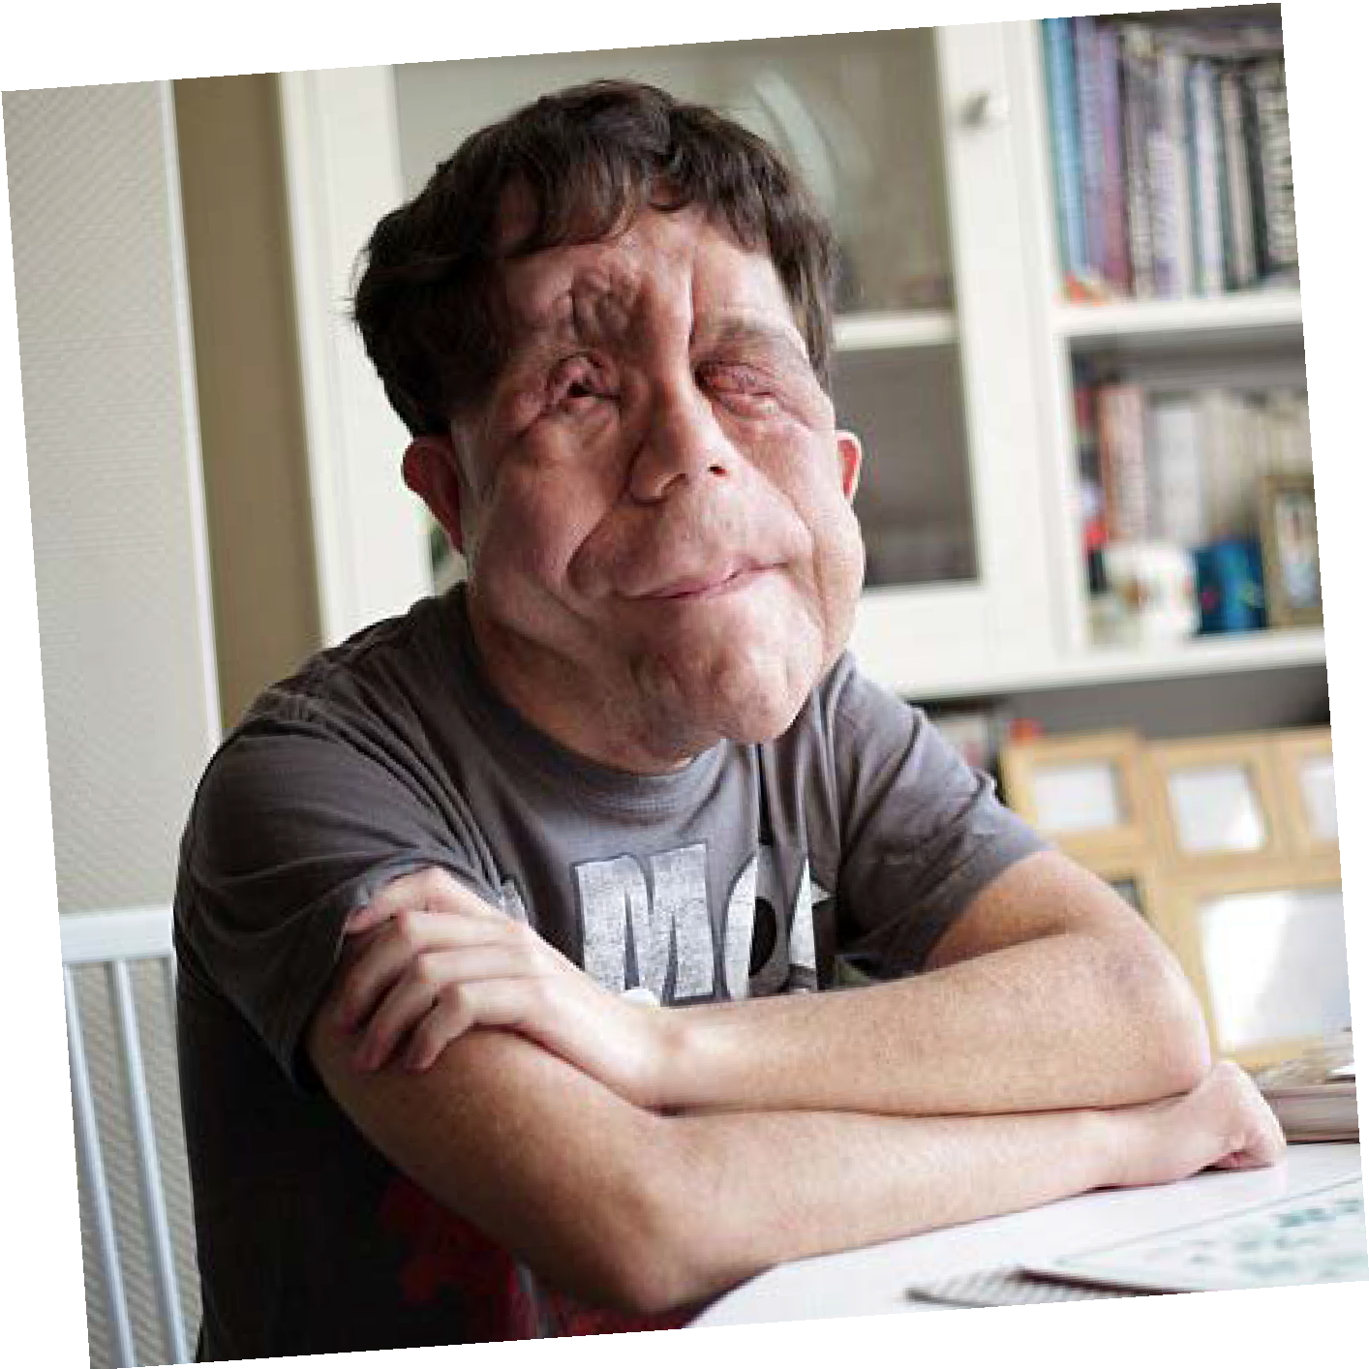
There are many types of visible diference
Credit: FashionStock.c^{om/Shutterstock.com}

Slide 10
ACTIVITY
In your group, make a list of film or TV characters that have a scar, mark or condition that affects their appearance.

Slide 11
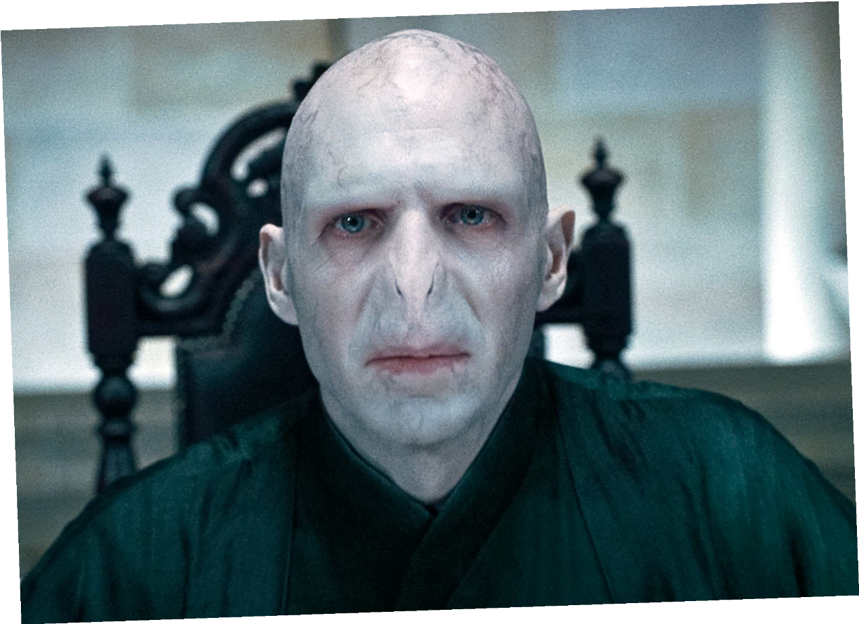
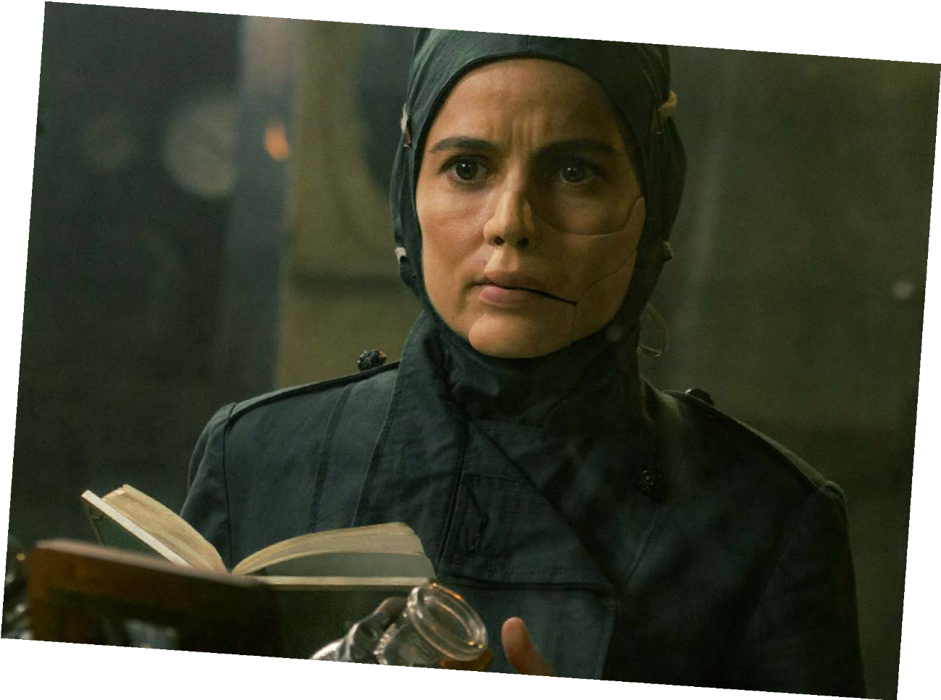
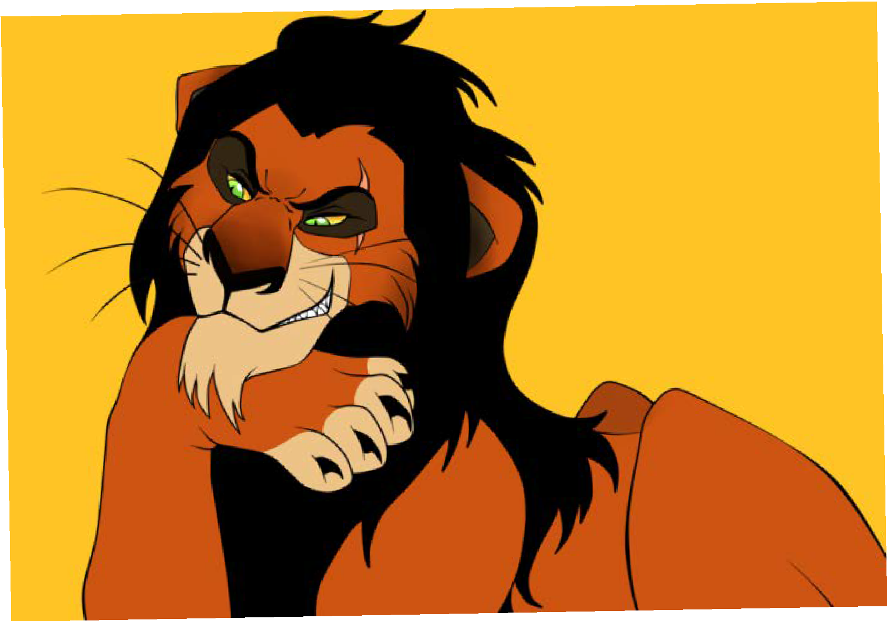
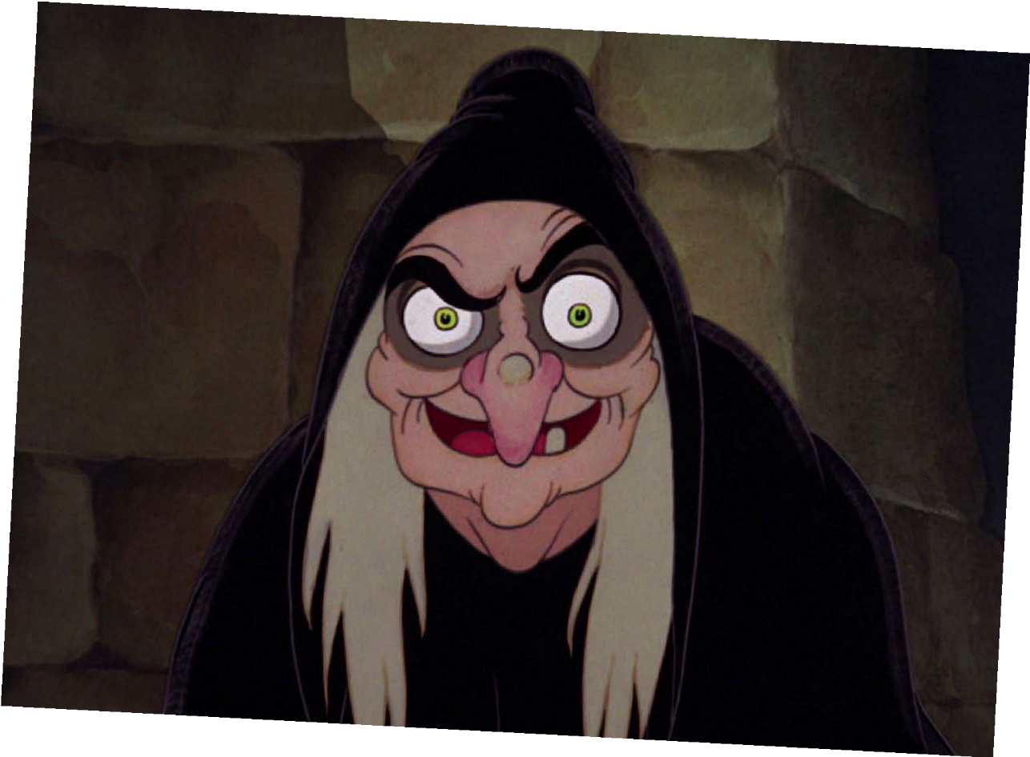
Voldemort
HARRY POTTER
and Ratpac-Dune Entertainment LLC
©Warner Bros. Entertainment Inc.
©Warner Bros. Entertainment Inc.
Dr Poison
WONDER WOMAN
©Disney
Scar
THE LION KING
©Disney
The Evil Queen
SNOW WHITE

Slide 12
DISCUSSION
How might seeing stereotypes in films and on TV affect the feelings of people who have a visible difference?
Do you think seeing stereotypes makes people treat others differently, if they look different?

Slide 13
TIME TO
REFLECT
What have you learned about stereotypes?

Slide 14
Other helpful
websites:
youngminds.org.uk
Find out more about visible differences and respecting difference: changingfaces.org.uk
Worried about anything we’ve discussed?
You can contact Childline for help:
childline.org.uk
respectme.org.uk

Slide 15
A WORLD OF
DIFFERENCE
Recognising and challenging stereotypes of visible difference
PRIMARY LESSON TWO
Primary Lesson Two ©Changing Faces 2021
15

Slide 16
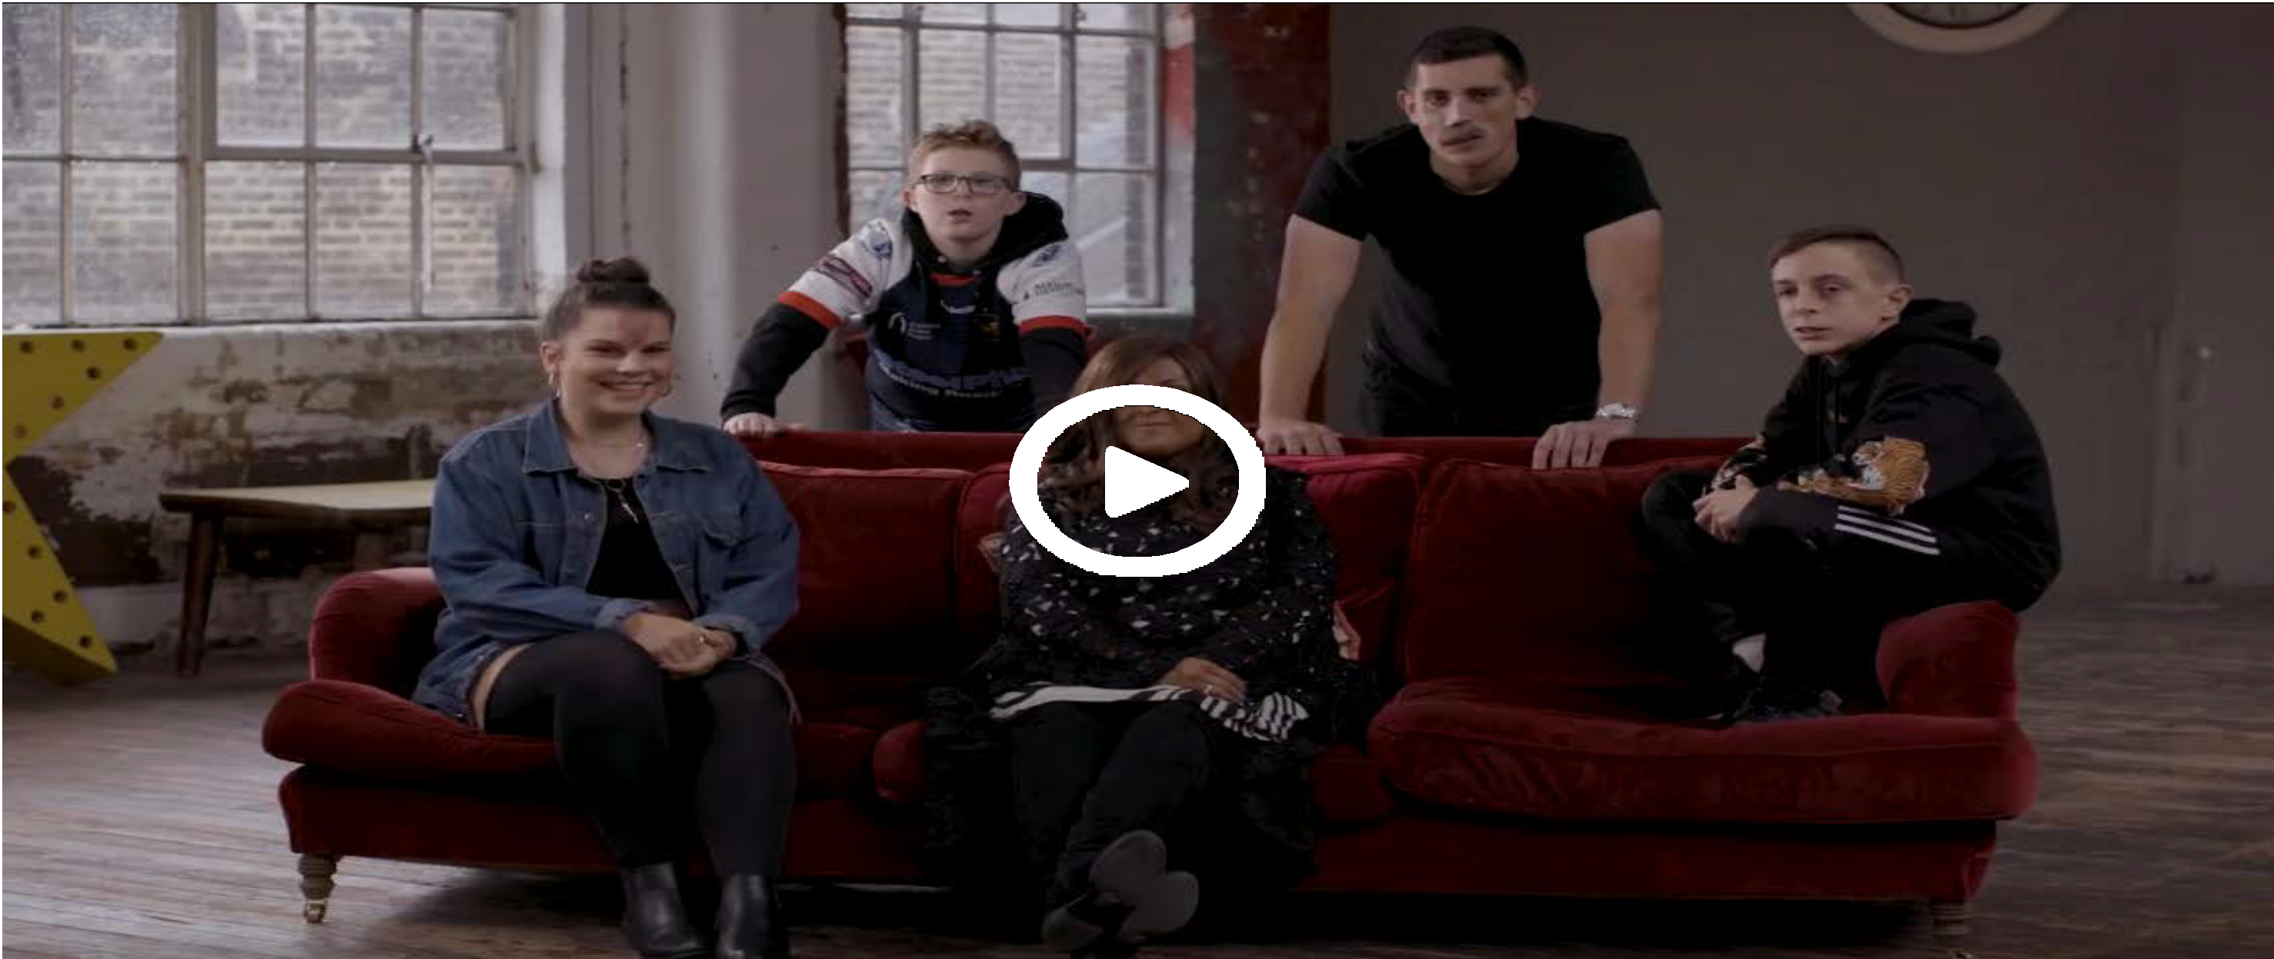
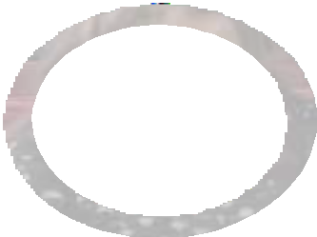

#iamnotyourvillain
For the video to work, please make sure you are in slideshow mode.
16

Slide 17
Other helpful
websites:
youngminds.org.uk
Find out more about visible differences and respecting difference: changingfaces.org.uk
Worried about anything we’ve discussed?
You can contact Childline for help:
childline.org.uk
respectme.org.uk
17

