Slide 1




A WORLD OF
DIFFERENCE
Recognising and challenging stereotypes of visible difference
Primary Assembly ©Changing Faces 2021
1

Slide 2
CHARACTER
QUIZ
Are these film characters goodies or baddies?

Slide 3
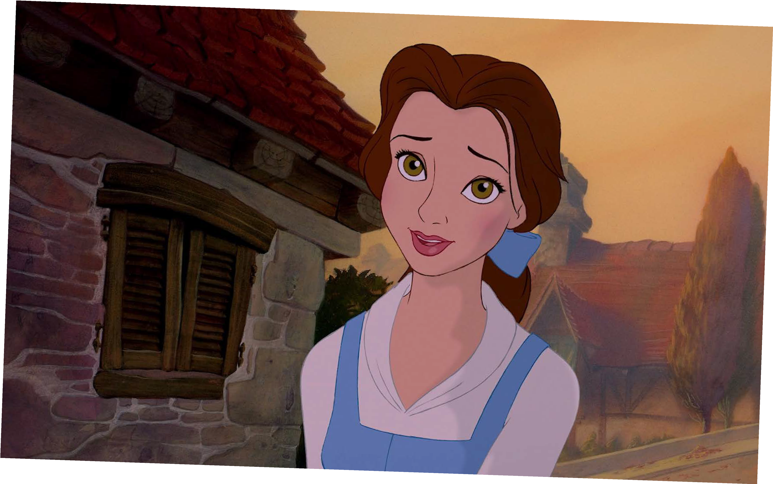
GOODIE!
©Disney
Belle
BEAUTY AND THE BEAST

Slide 4












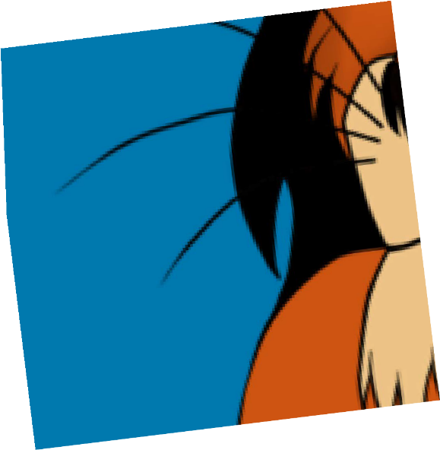




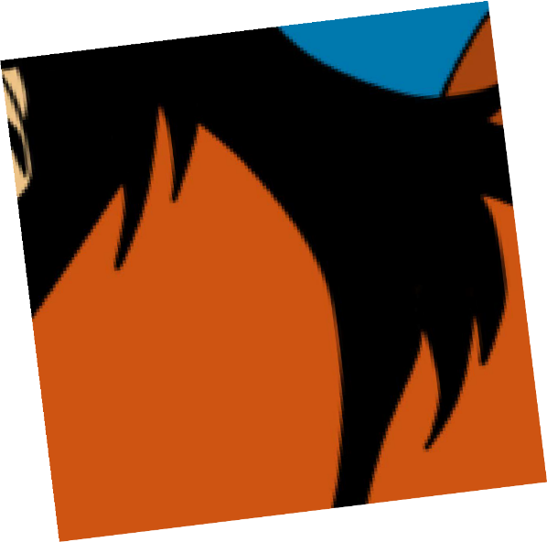

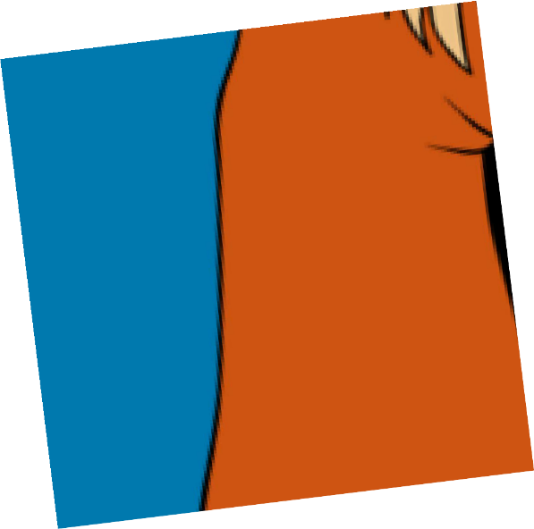





BADDIE!
Scar
THE LION KING
©Disney

Slide 5
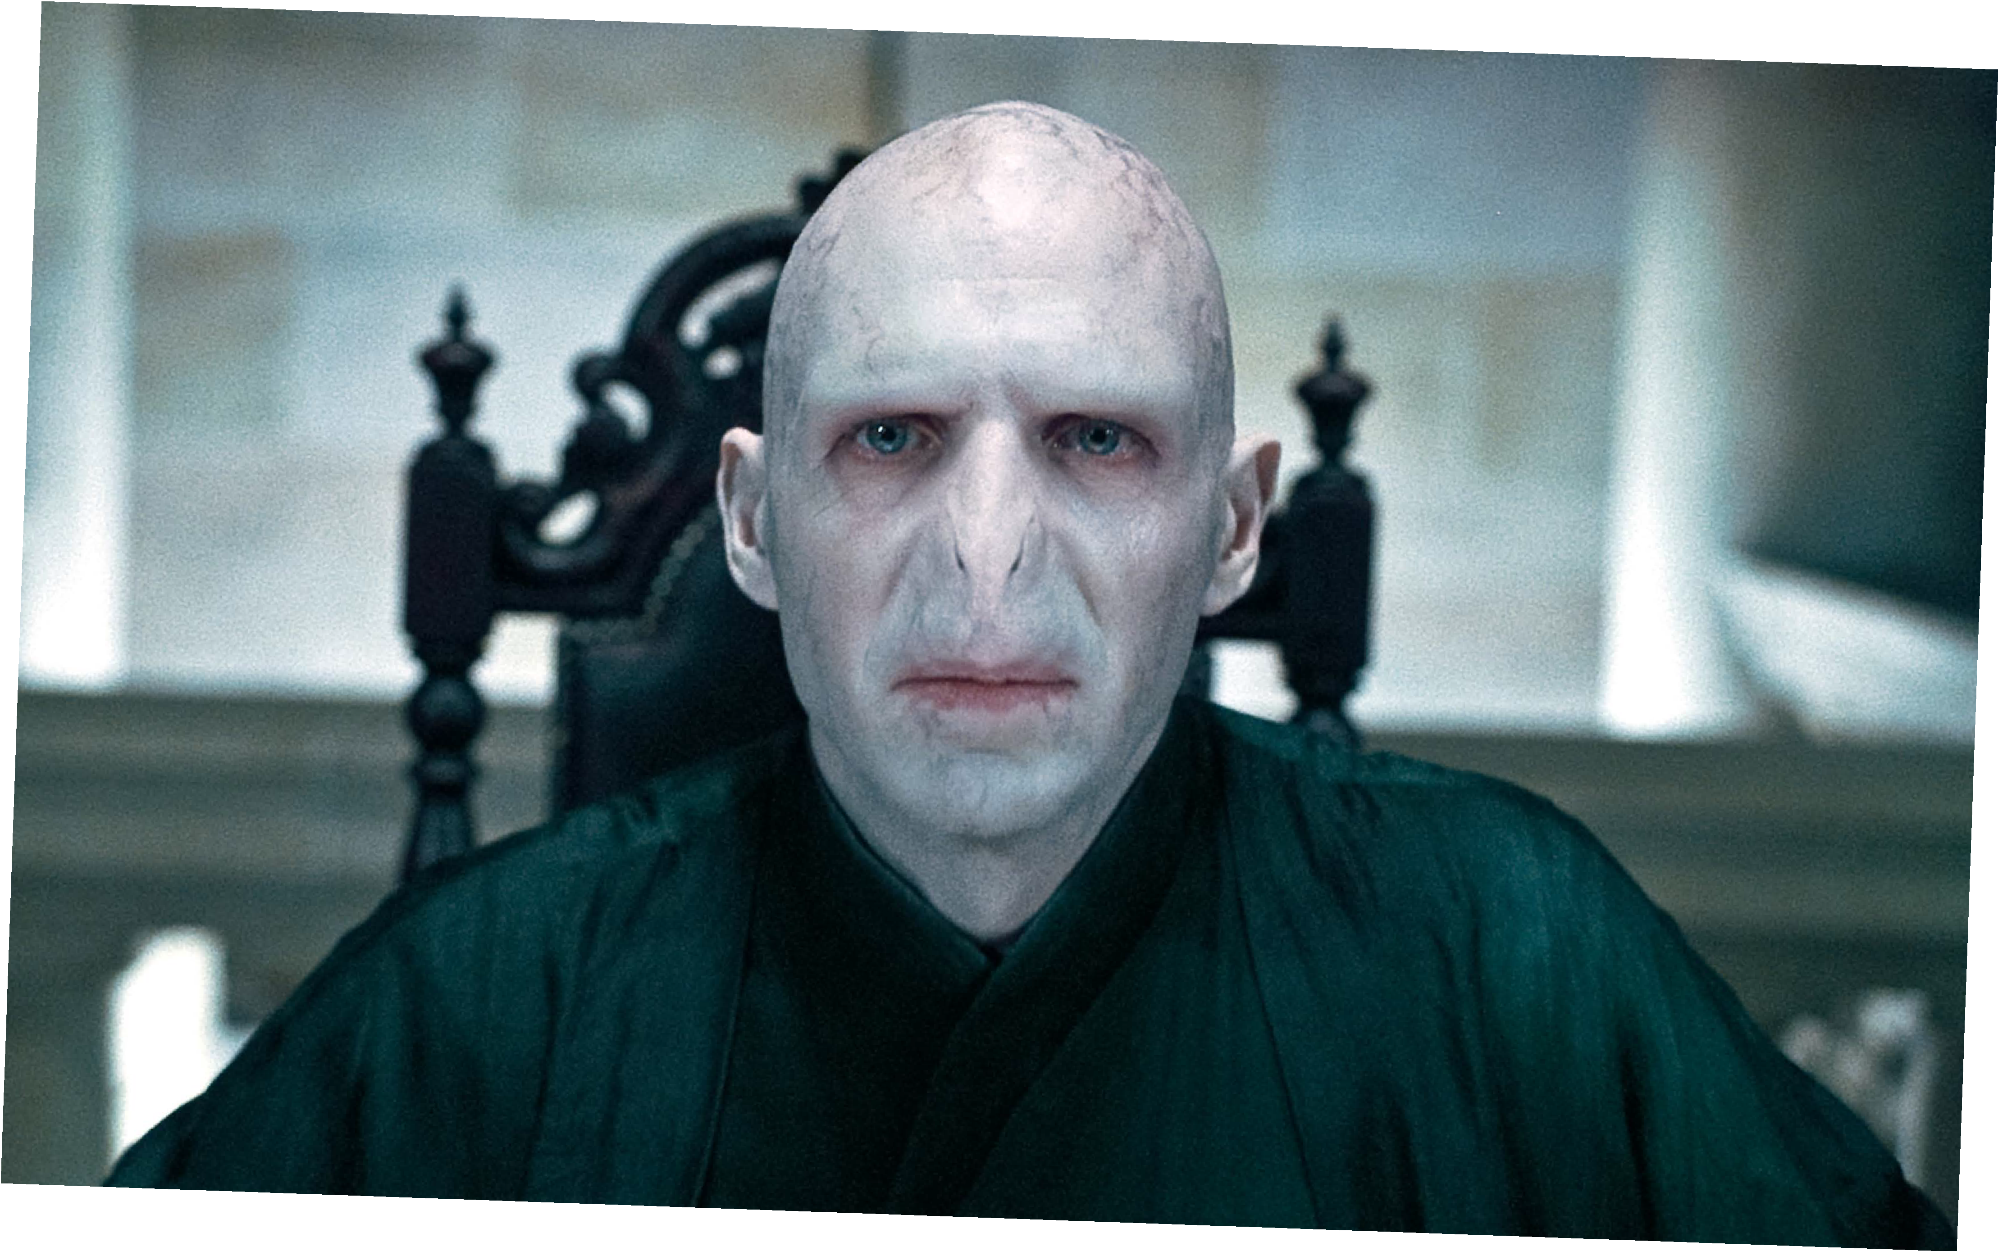
BADDIE!
©Warner Bros. Entertainment Inc.
Voldemort
HARRY POTTER

Slide 6
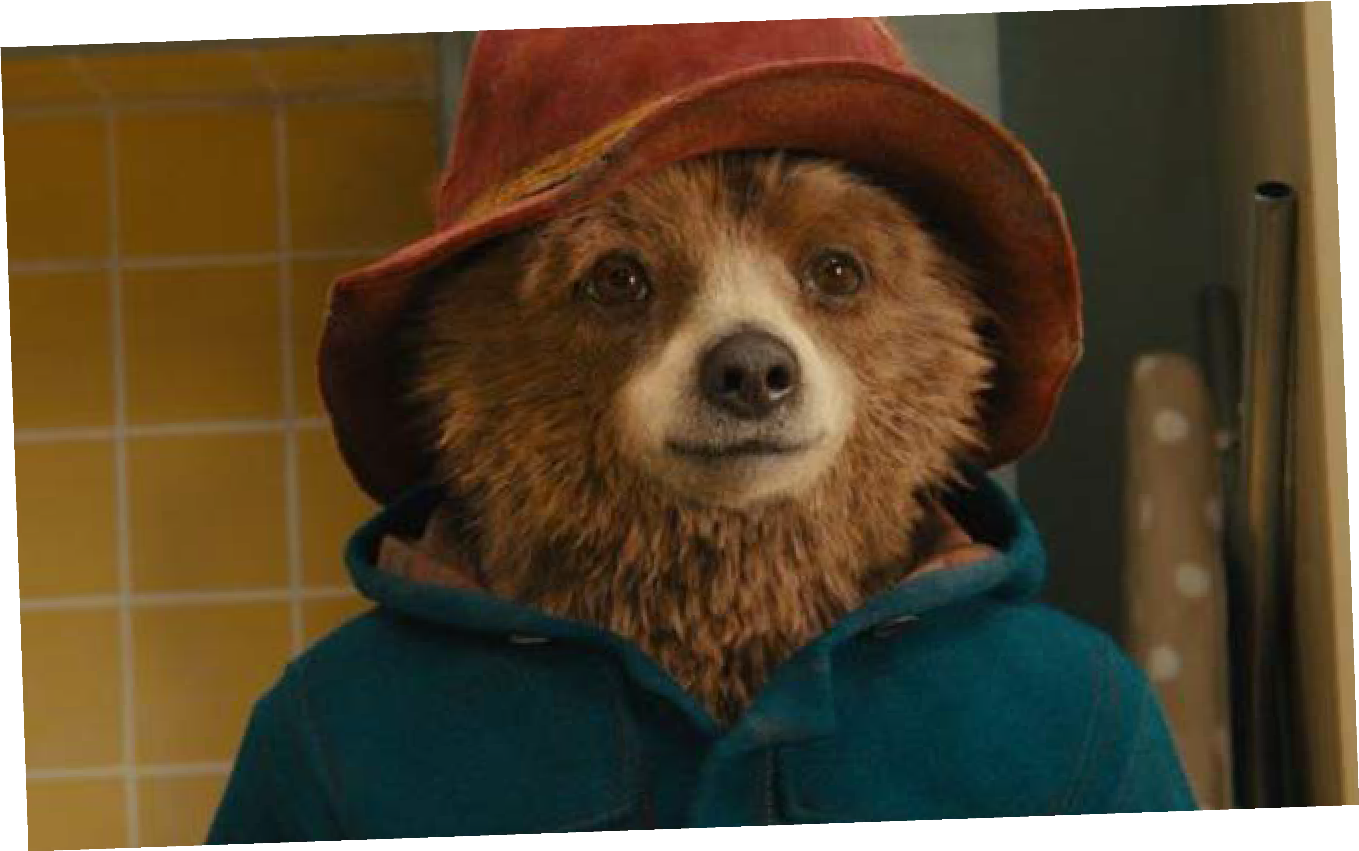
GOODIE!
Paddington
PADDINGTON BEAR
©Studio Canal

Slide 7
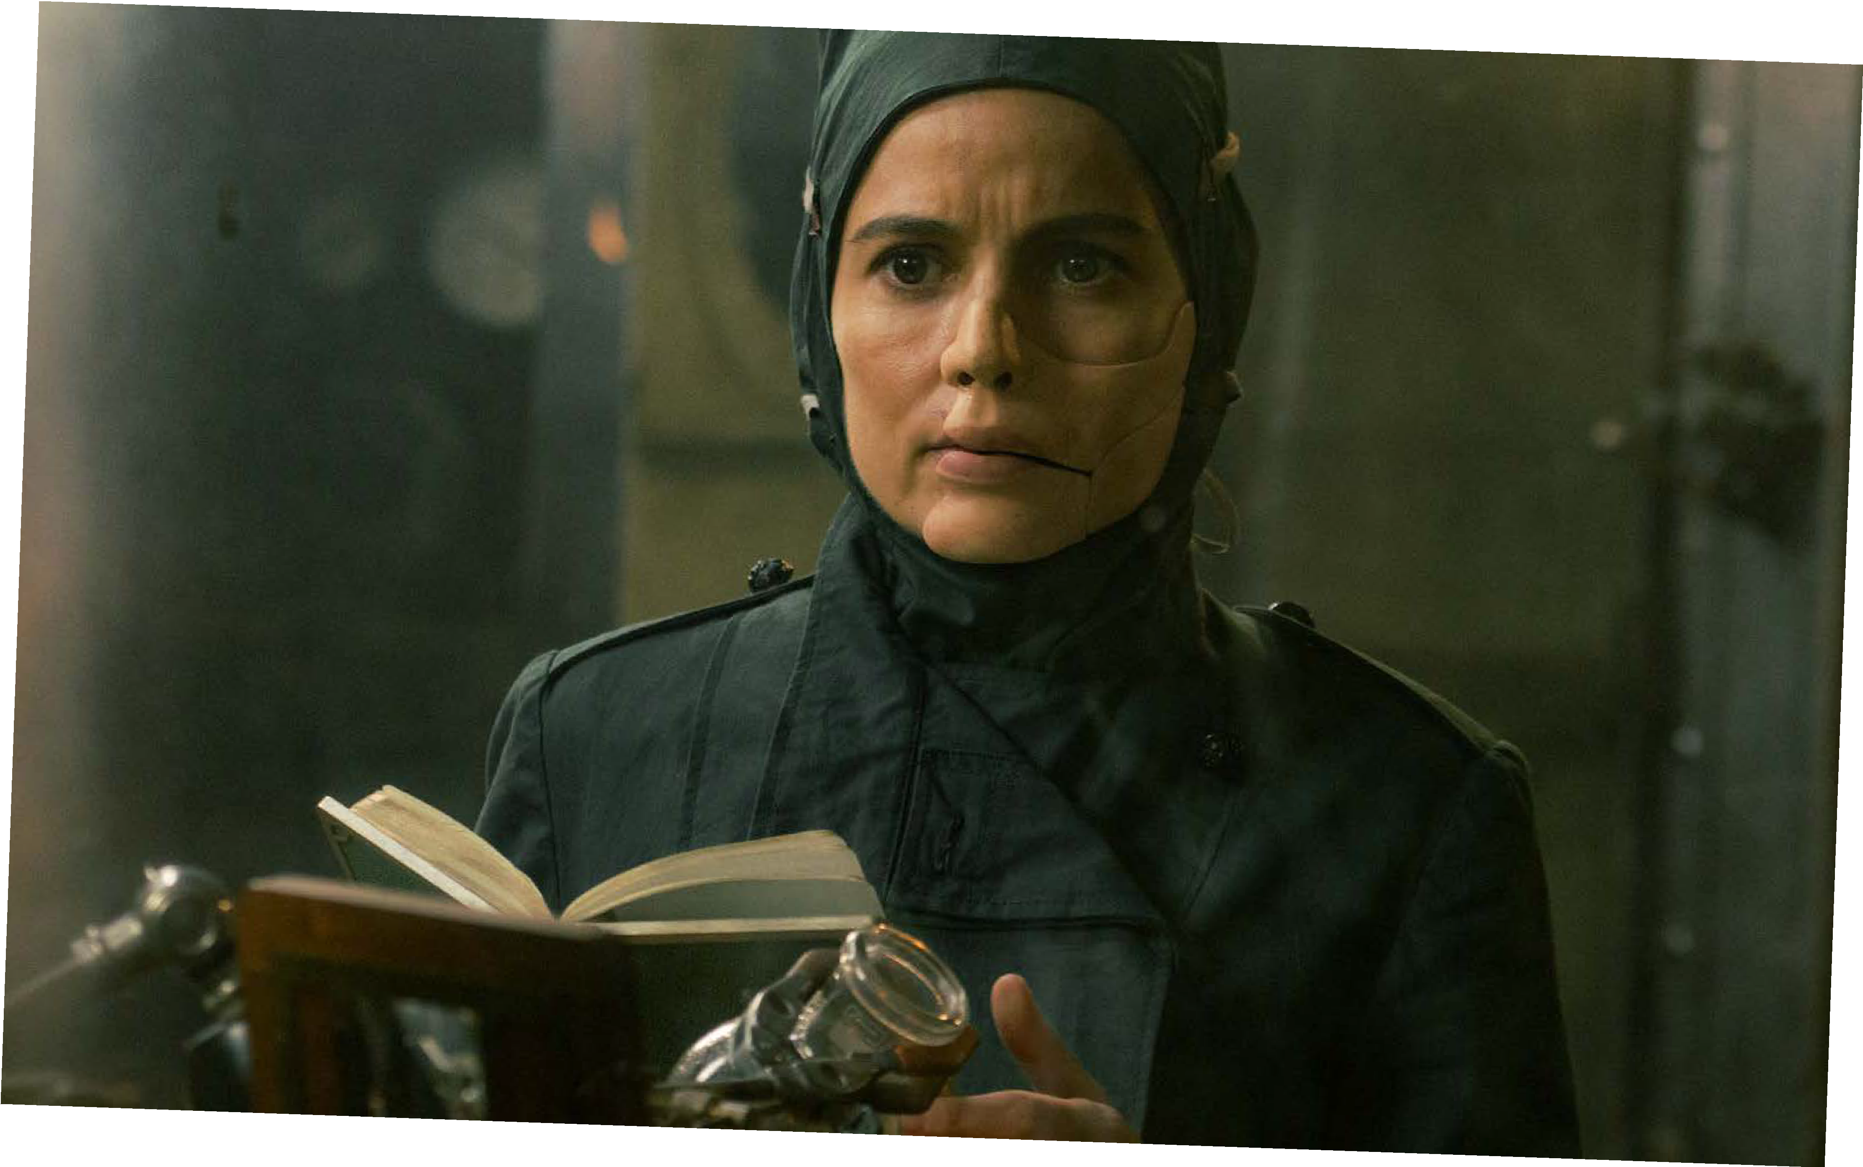
BADDIE!
©Warner Bros. Entertainment Inc. and Ratpac-Dune Entertainment LLC
Dr Poison
WONDER WOMAN

Slide 8
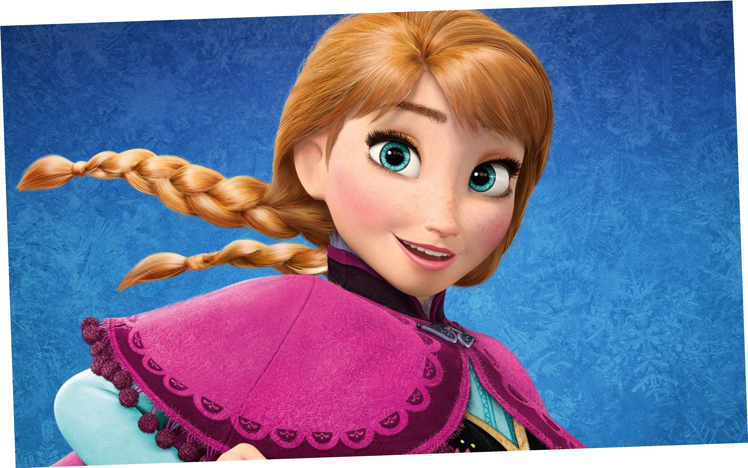
GOODIE!
Anna
FROZEN
©Disney

Slide 9
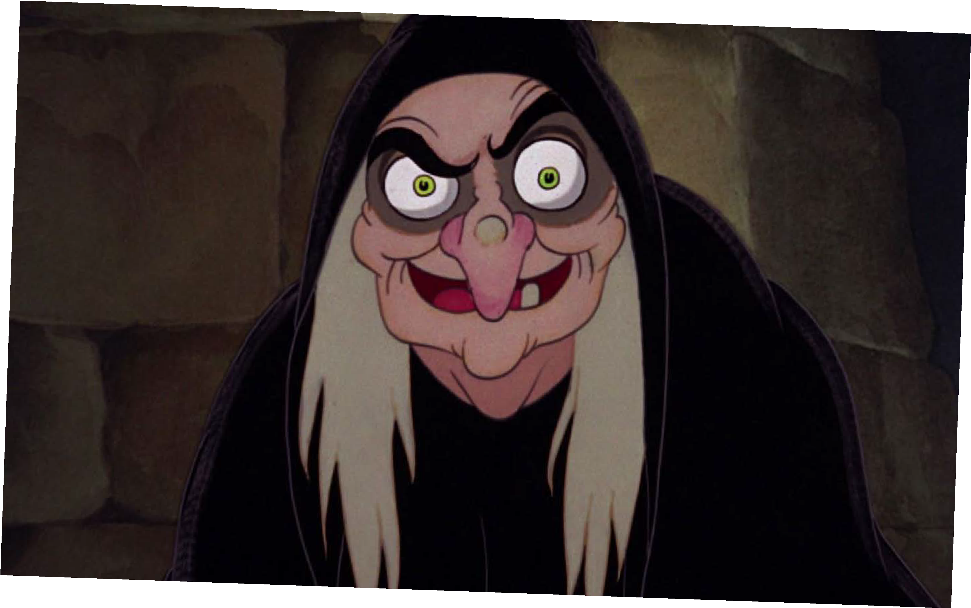
BADDIE!
©Disney
The Evil Queen
SNOW WHITE

Slide 10
GROUP
DISCUSSION
What did you notice about how the baddies looked?

Slide 11
A stereotype is an idea about a particular group of people that is often untrue or unfair.

Slide 12
Lots of films and TV programmes use the stereotype that if you look different, you must be a baddie. This is really hurtful to people who look different in real life.

Slide 13
A visible difference is a mark, scar or condition that affects the appearance
of someone’s face or body.

Slide 14
Causes of a visible difference:
Skin conditions like eczema, acne, or vitiligo
Burns
Birthmarks
Craniofacial conditions, affecting the growth and development of the skull and face
Cleft lip/palate (a gap or split in the upper lip and/or roof of the mouth)
Cancer

Slide 15
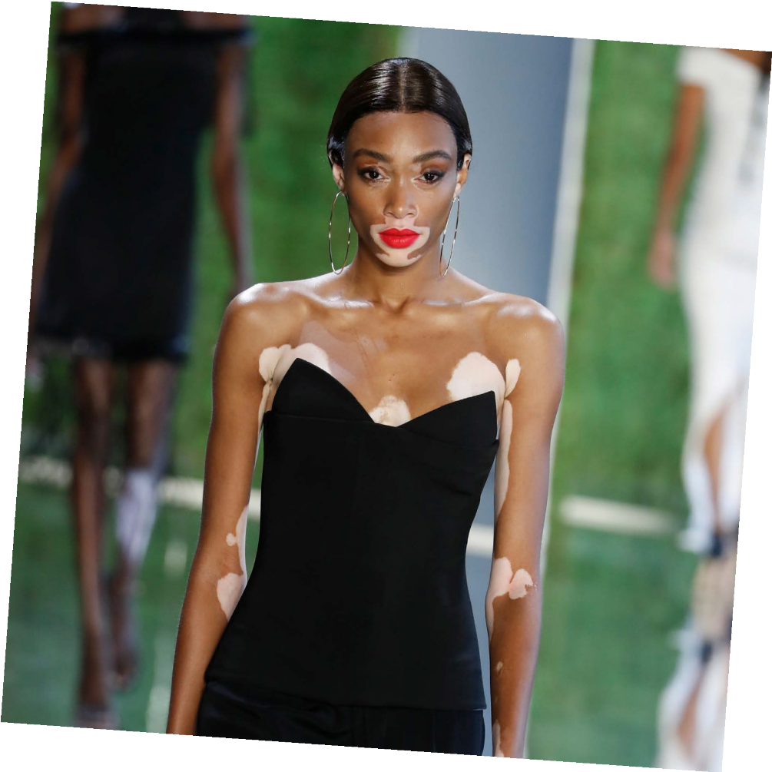
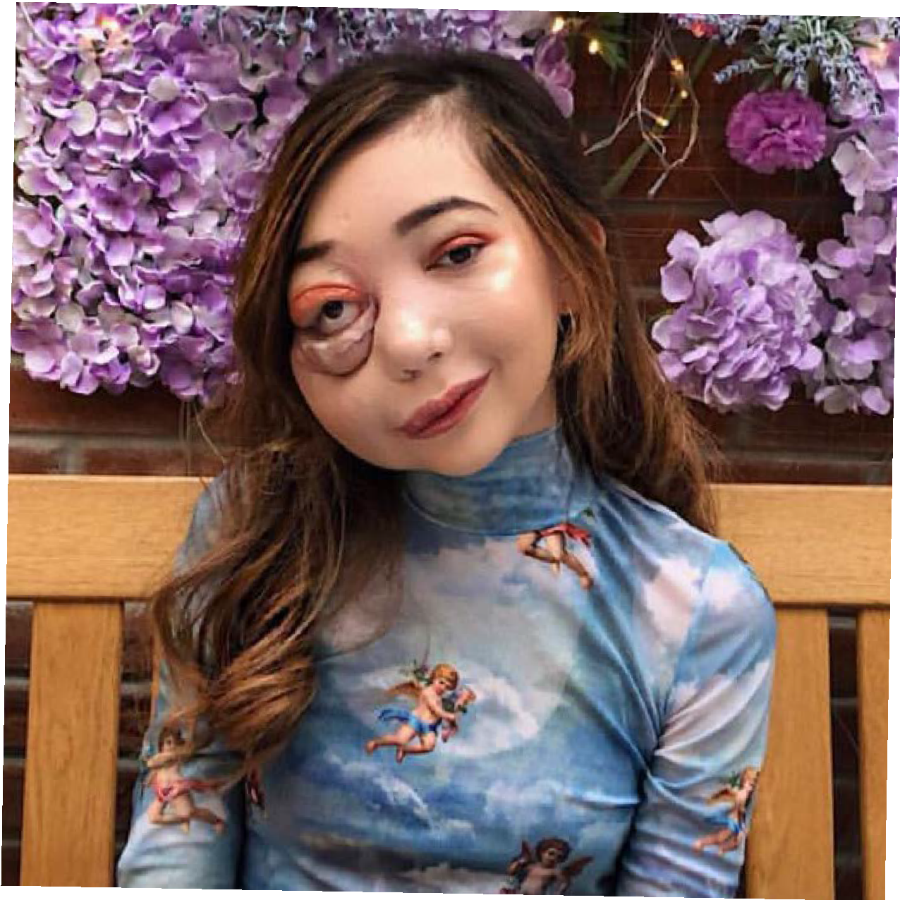
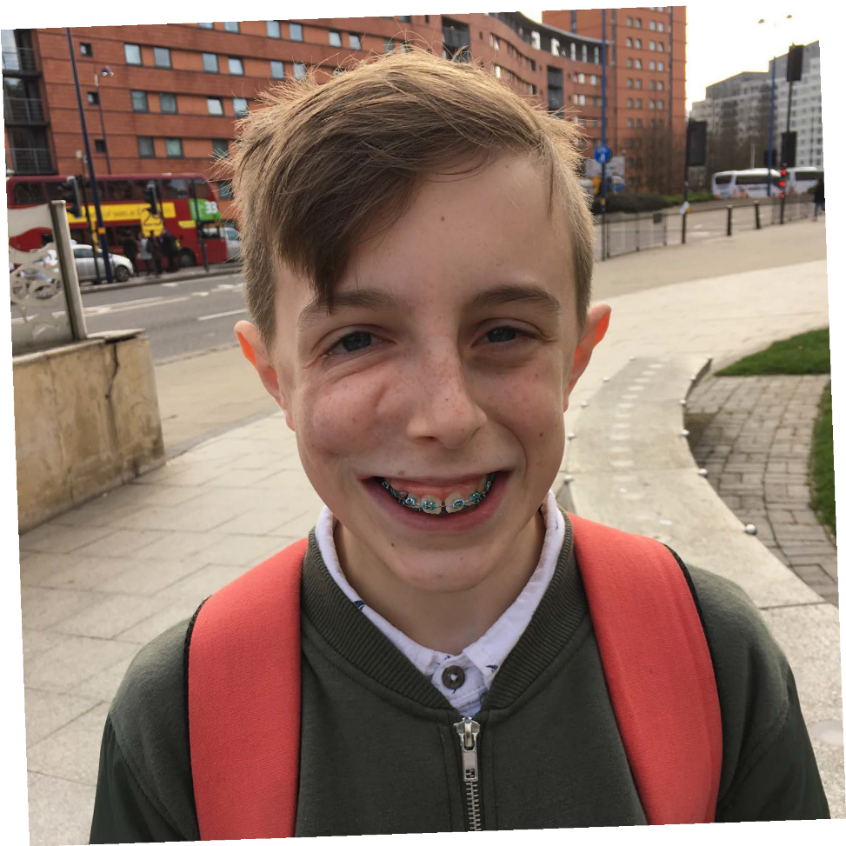
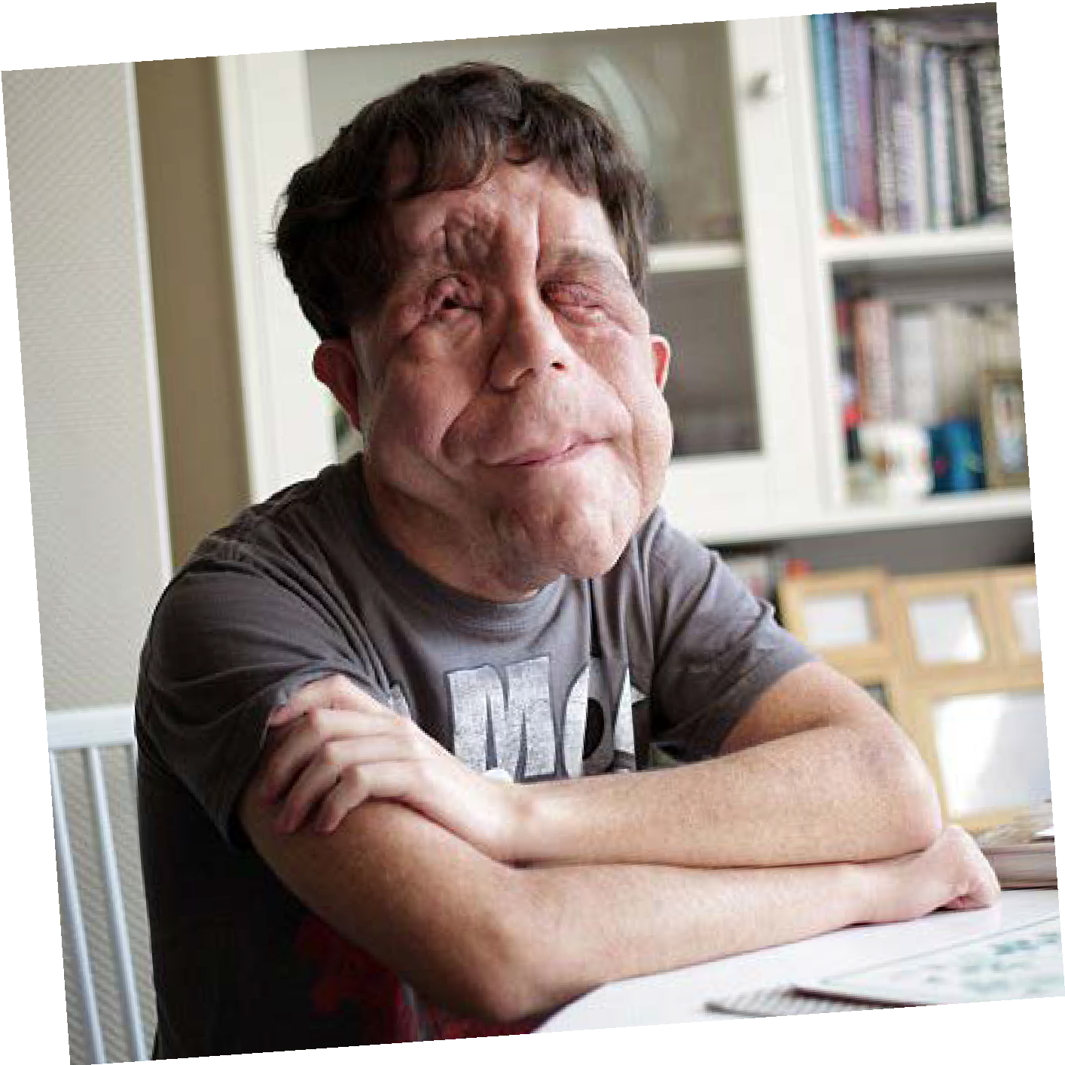
There are many types of visible diference
Credit: FashionStock.c^{om/Shutterstock.com}

Slide 16
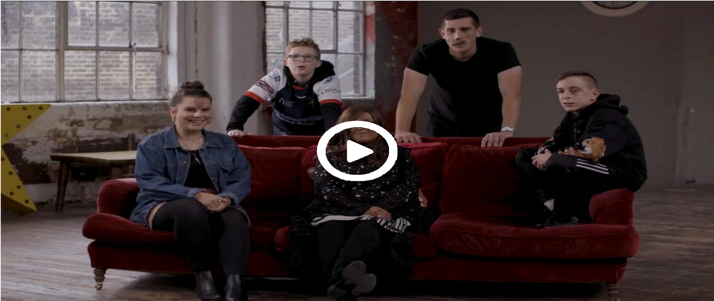
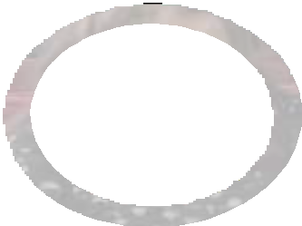

#iamnotyourvillain
For the video to work, please make sure you are in slideshow mode.

Slide 17
Other helpful
websites:
youngminds.org.uk
Find out more about visible differences and respecting difference: changingfaces.org.uk
Worried about anything we’ve discussed?
You can contact Childline for help:
childline.org.uk
respectme.org.uk

