Slide 1


Slide 2

Session aims
To look at some of the resources for use in school.
To listen to children and young people and schools to begin to reflect on effective practices.

Slide 3

Session One takeaways
In Session One, you were asked to:
Identify three key points that you took away from the session.
Keep a record of how having a better understanding of the impact of difference and unconscious/implicit bias influenced your practice.

Slide 4

GROUP
DISCUSSION
Take five to ten minutes in your groups to discuss your experiences. Each group will then share their feedback.

Slide 5

Activities to try at school
When you are next in school, we would like you to try using some of the resources that have been developed by Changing Faces.
We will be trying out some of these activities in this session, so you can think about how best to use them in your classroom or setting.
The resources and teacher guide can be accessed from changingfaces.org.uk/for-professionals/teachers-youth-workers/ classroom-resources

Slide 6
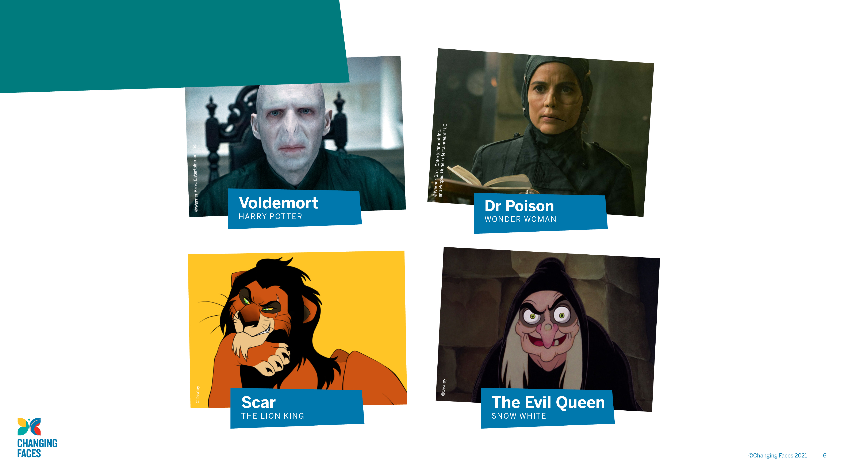
This is one of the school activities.
What do you notice about these images?

Slide 7
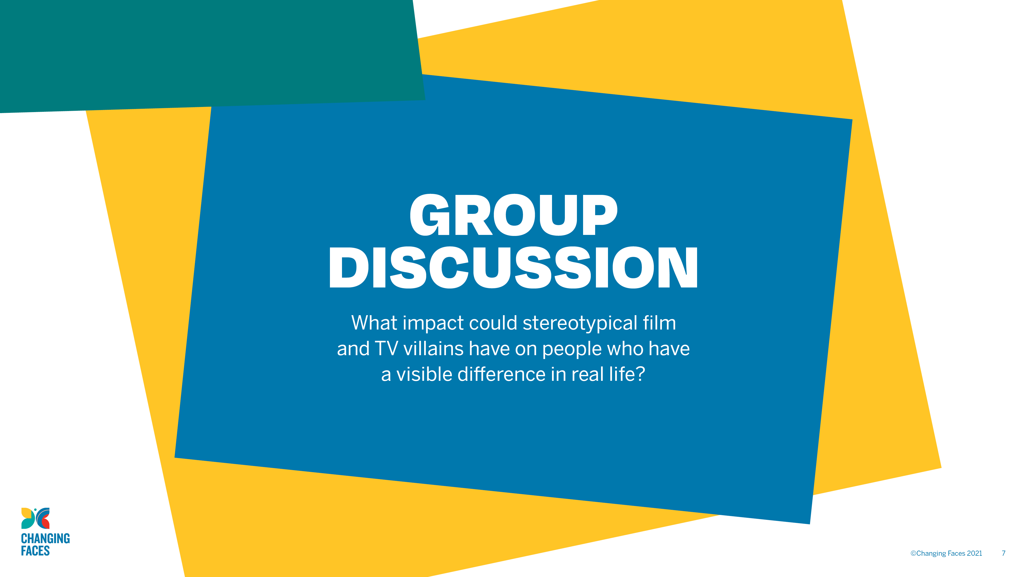
Discuss this question, thinking about how students could be supported.

Slide 8
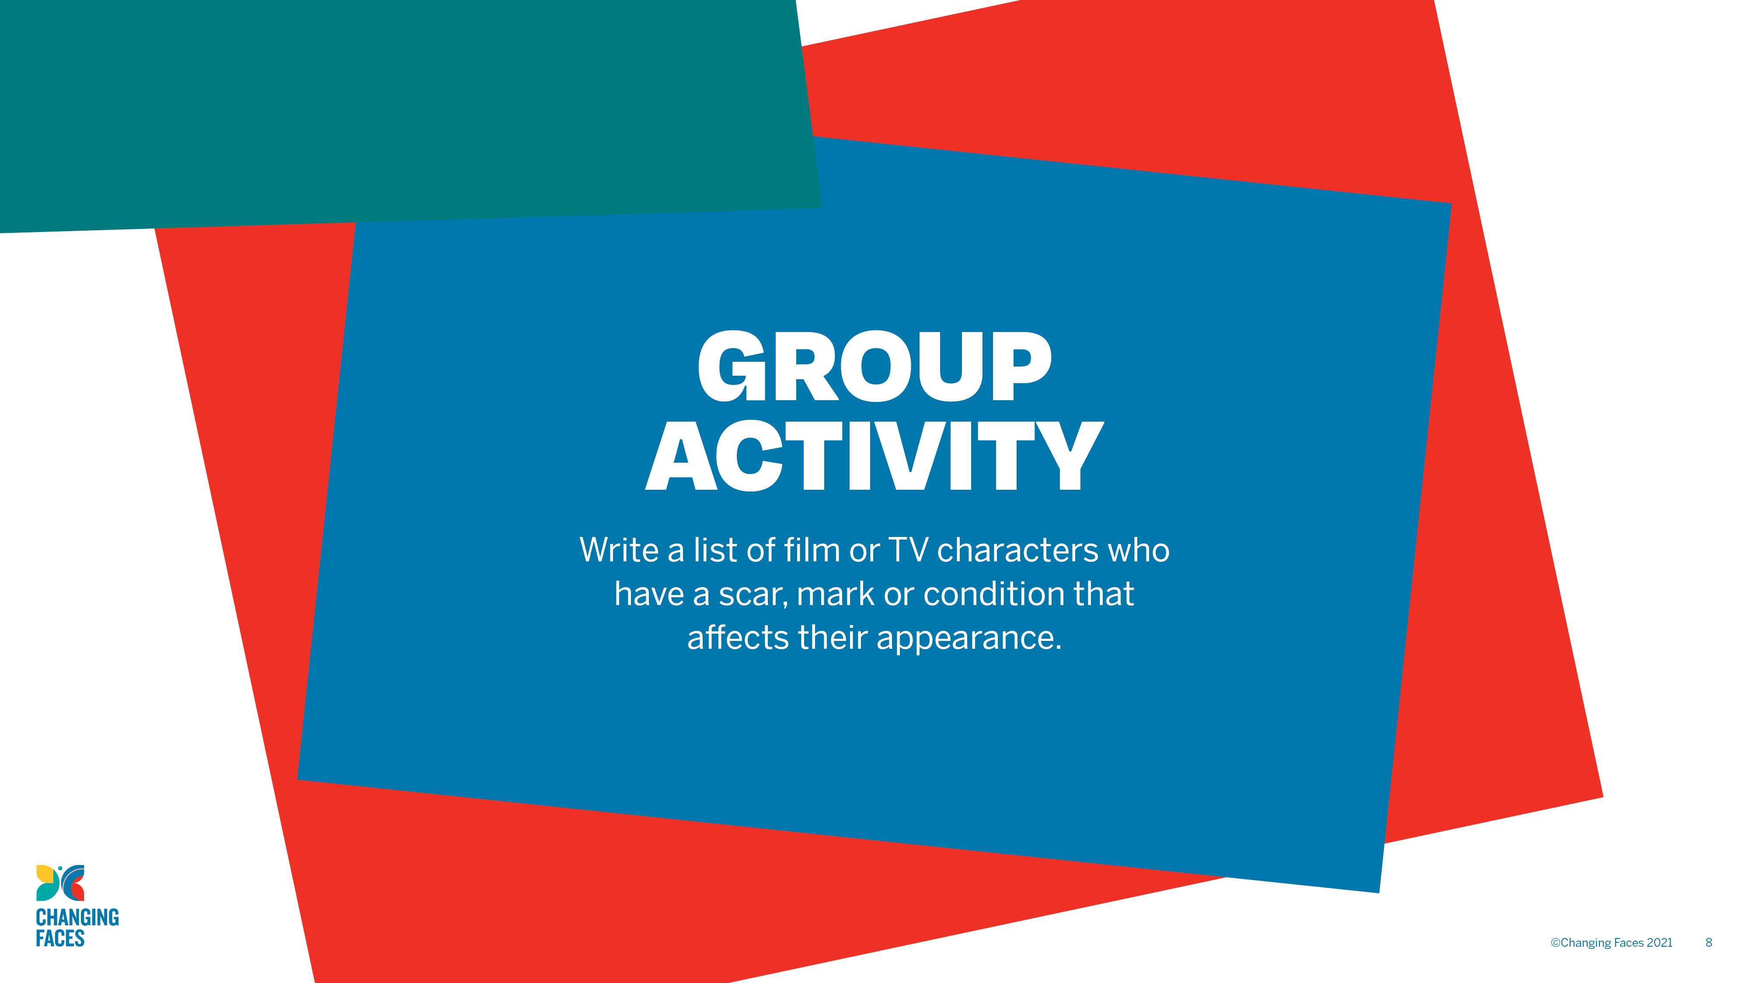
Try this activity and then answer the question: how many of the characters do we associate with positive characteristics?

Slide 9

What about holding an assembly?
Assemblies can be a useful alternative to lessons if time is short. We’re going to look at a section of the resources for an assembly.

Slide 10
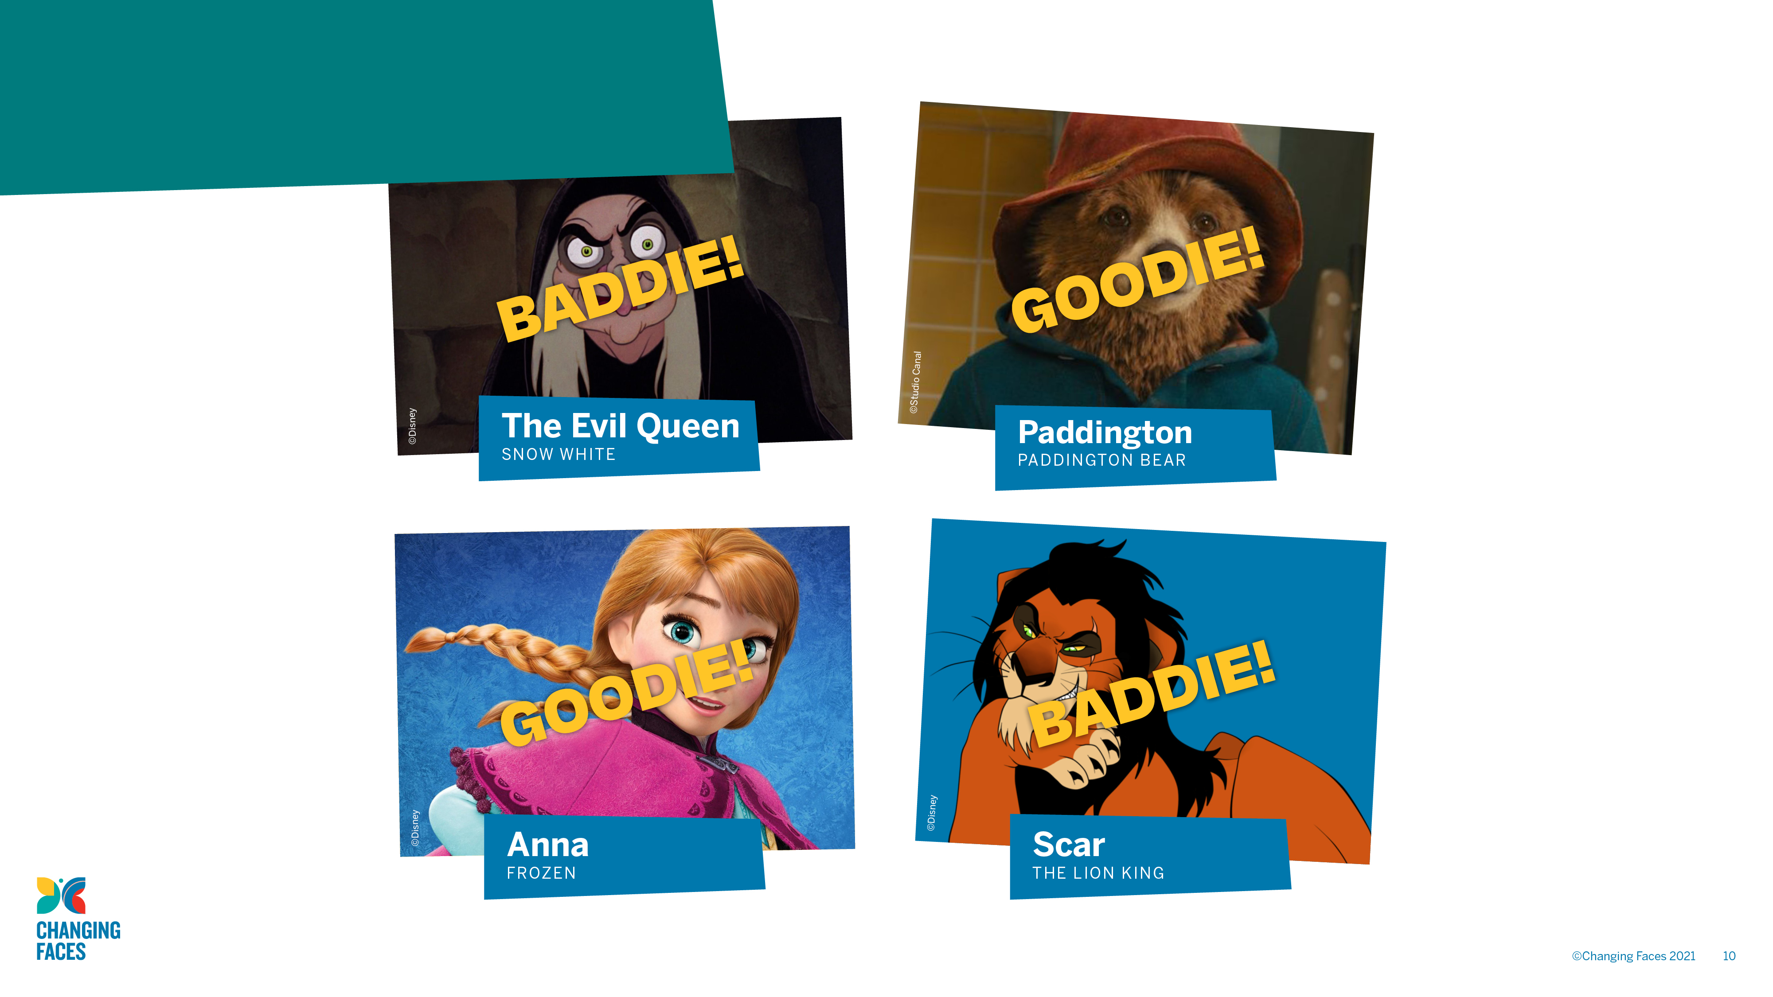
The Assembly quiz asks pupils if these film characters are goodies or baddies.

Slide 11

Key messages from the Assembly
A stereotype is an idea about a particular group of people that is often untrue or unfair.
Lots of films and TV programmes use the stereotype that if you look different, you must be a baddie. This is really hurtful to people who look different in real life.
A visible difference is a mark, scar or condition that affects the appearance.

Slide 12

Feedback and comments
From your experience so far, how easy do you think it would it be to implement any of these activities in your school?
What adaptations might you have to make to ensure that the resources are appropriate for your setting?
How could you prepare for the session?
What follow-up activities/changes could you put in place to develop the ideas further?

Slide 13
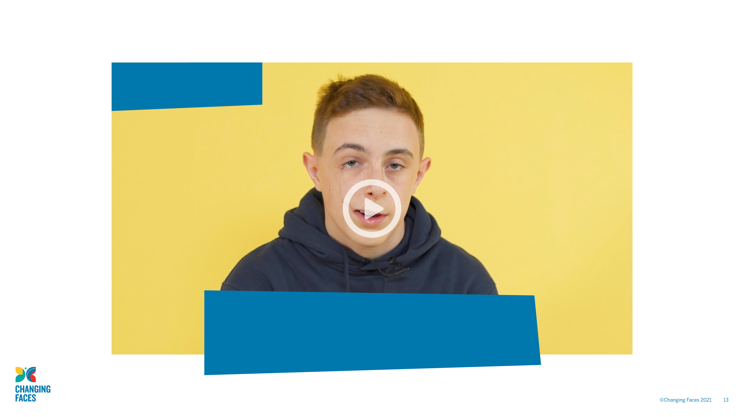
Children and young people’s voices
When watching this video, think about anything that surprises you and the key messages you take from the children and young people.

Slide 14

GROUP
DISCUSSION
Was there anything that surprised you?
What are the key messages you have taken from the children and young people?
What advice would you give their teachers?

Slide 15
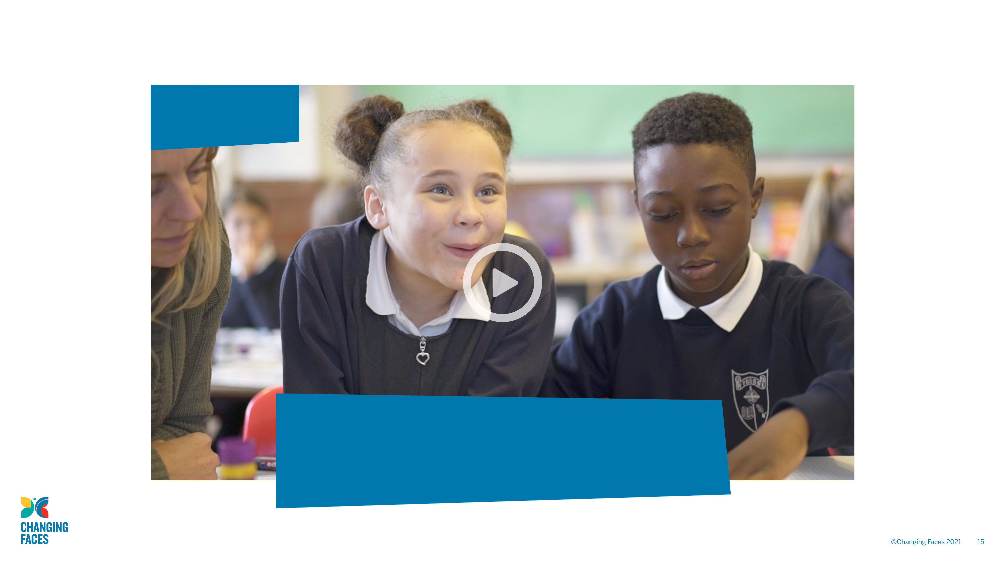
Teacher’s voices
Think about the differences between what the children and young people say and what teachers say about their priorities.

Slide 16

GROUP
DISCUSSION
What do you notice are the key differences between what the children and young people say and what teachers say about their priorities?
How could you use both perspectives to support a student with a visible difference in your class?

Slide 17

Session Review
Spend a few minutes reflecting on how your thinking has changed in relation to people with a visible difference. Once you have thought of two or three ideas, discuss them with the rest of your group.
How could you develop the ideas from the lesson/assembly activities to inform your classroom practice more widely?
Remember this is just the beginning, so don’t be afraid to make mistakes.
It is better to try and fail, than not to try at all.

Slide 18

Changing Faces resources
For more advice and support from Changing Faces go to:
changingfaces.org.uk/for-professionals/teachers-youth-workers

