Slide 1
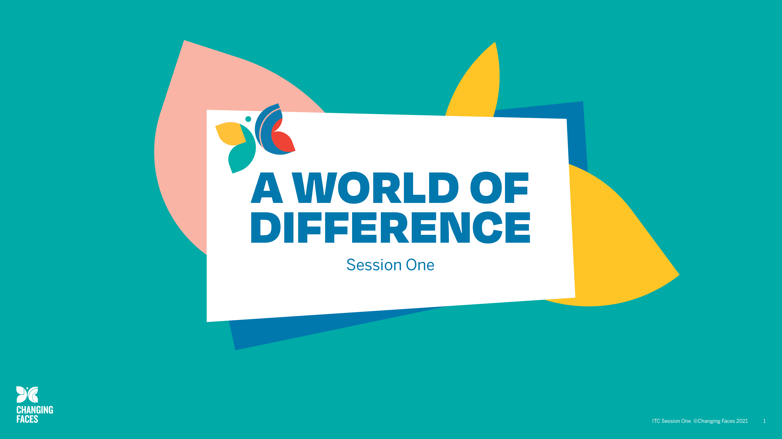

Slide 2

Session aims
Reflect on what it means to have a visible difference and its impact on the child, the family and the school.
Learn about unconscious (implicit) bias and have greater awareness of how this impacts our behaviour.
Understand more about living with a visible difference by listening to children with a visible difference and their parents.

Slide 3

Visible difference/disfigurement
What do you understand by the terms visible difference and disfigurement?
Why do you think there is a move towards using the phrase ‘visible difference’ rather than ‘disfigurement’?
Discuss these in your groups and make notes, so we can take feedback.

Slide 4

Some causes of visible difference:
Skin conditions like eczema, acne, or vitiligo
Burns
Birthmarks
Craniofacial conditions, affecting the growth and development of the skull and face
Cleft lip/palate (a gap or split in the upper lip and/or roof of the mouth)
Cancer

Slide 5
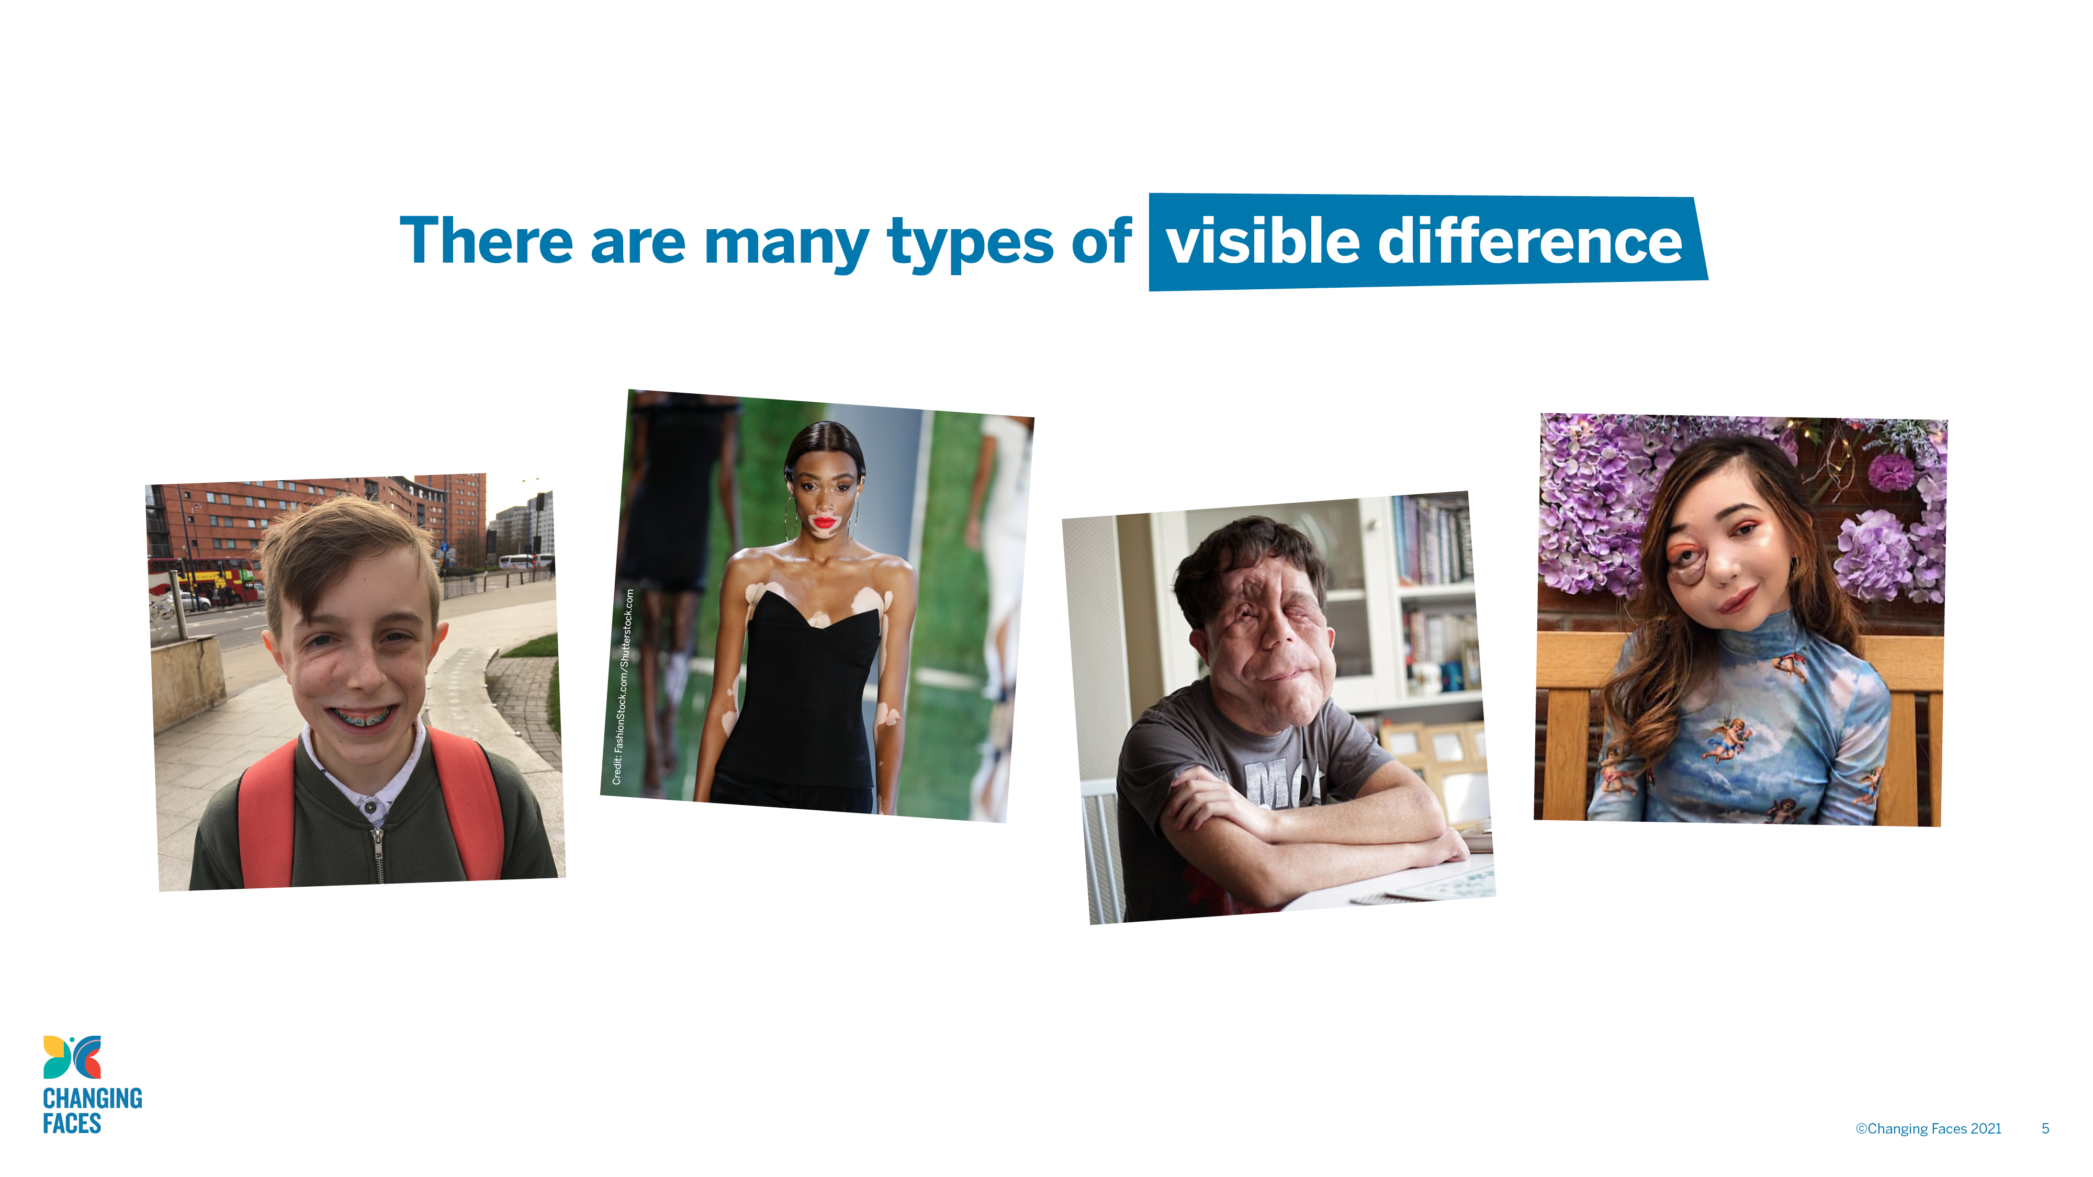

Slide 6
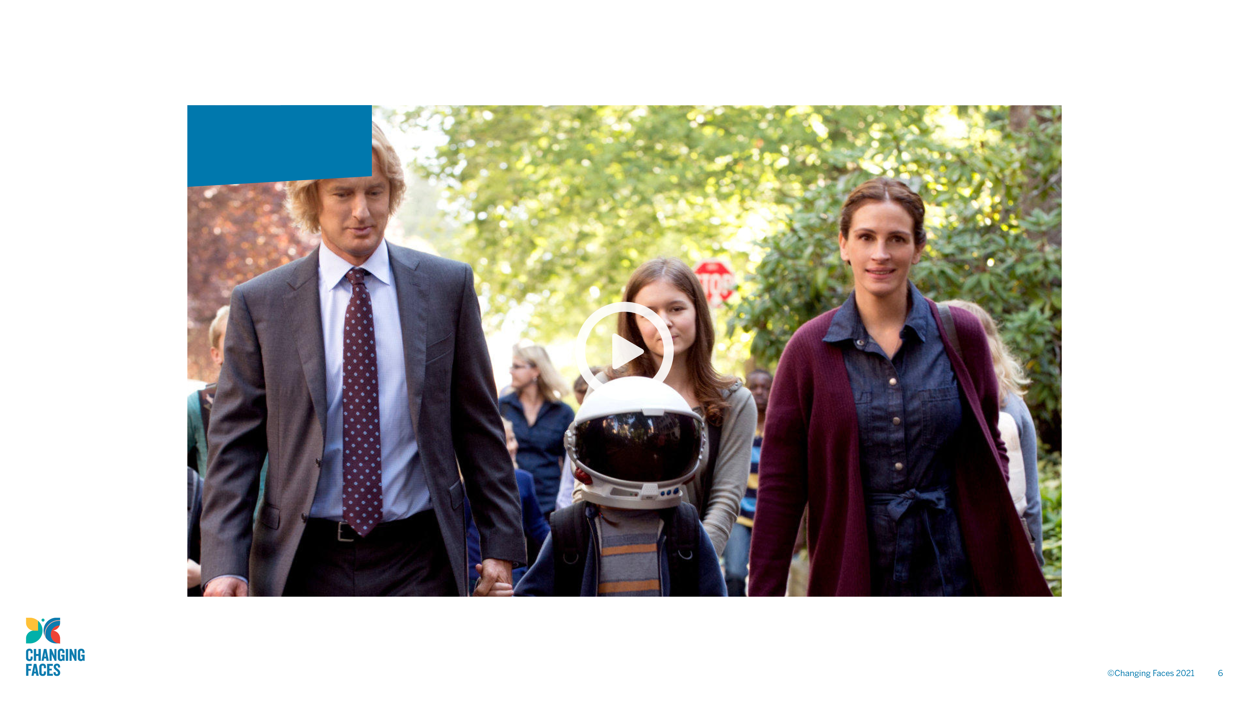
Wonder
trailer

Slide 7

GROUP
DISCUSSION
When you see the clip of Wonder for the second time, reflect on the following questions and then discuss them in your groups.

Slide 8
What do you think the filmmaker wanted you to think and feel when Auggie takes off his helmet for the first time?
What did you notice as Auggie walked through the playground for the first time?
If you were Auggie, how would you feel walking through the playground for the first time?
What do you think Auggie’s parents were thinking as they watched him go into the playground for the first time?
What do you think the other children were thinking as they watched Auggie walk through the playground for the first time?

Slide 9

Wonder
trailer

Slide 10
What do you think the filmmaker wanted you to think and feel when Auggie takes off his helmet for the first time?
What did you notice as Auggie walked through the playground for the first time?
If you were Auggie, how would you feel walking through the playground for the first time?
What do you think Auggie’s parents were thinking as they watched him go into the playground for the first time?
What do you think the other children were thinking as they watched Auggie walk through the playground for the first time?

Slide 11

GROUP
DISCUSSION
If you had a child like Auggie joining your class, what would you want to know and what do think some of the challenges might be?

Slide 12

Equality Act (2010): Severe disfigurement
An impairment which consists of a severe disfigurement is to be treated as having a substantial adverse effect on the ability of the person concerned
to carry out normal day-to-day activities.

Slide 13

GROUP
DISCUSSION
Why do you think the Equality Act includes ‘severe disfigurement’ as a disability that has an adverse effect on the ability of a person to carry out normal day-to-day activities?

Slide 14

United Nations Convention on the Rights of Persons with Disabilities
Under articles 7 and 24 of the United Nations Convention of the Rights
of Persons with Disabilities, the UK Government is committed to inclusive education of disabled children and young people and the removal of
barriers to learning and participation in mainstream education.
With this commitment comes a responsibility for schools to ensure that children with a visible difference are given their right to participate fully.

Slide 15

GROUP
DISCUSSION
What do you think unconscious
(or implicit) bias means?

Slide 16

Unconscious (or implicit) biases
Unlike conscious biases, unconscious (or implicit) biases are the views
and opinions that we are unaware of; they are automatically activated and frequently operate outside conscious awareness and affect our everyday behaviour and decision making. Our unconscious biases are influenced
by our background, culture, context and personal experiences.
Equality and Human Rights Commission, 2018, pp.4-5

Slide 17
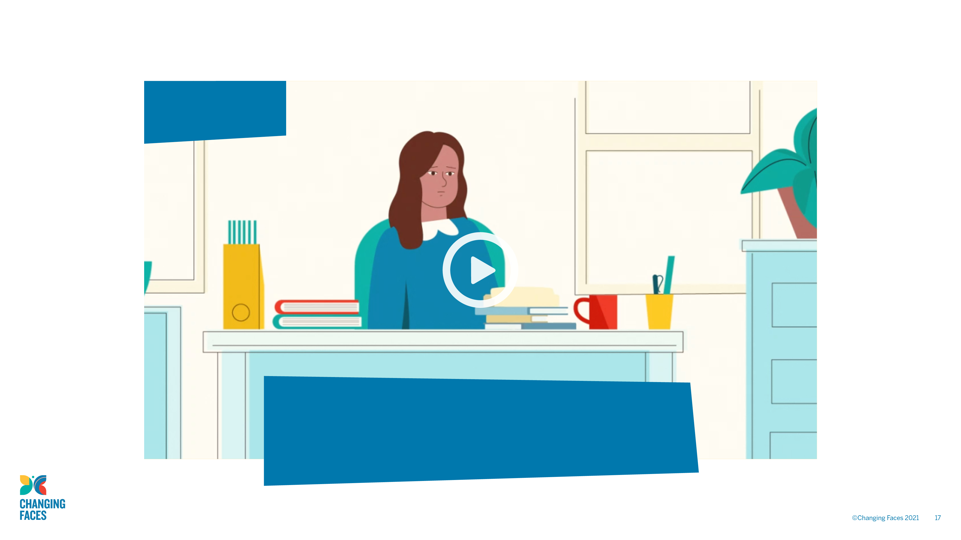
Unconscious Bias
Note the things that surprise you in this film about the impact of unconscious (or implicit) bias in the classroom.

Slide 18

Reaction and response
Our initial reaction to a situation or event is instinctive and is not something we have control over.
Our reaction to disfigurement/visible difference might be discomfort and avoidance, due to repeated associations of disfigurement/visible difference
with negative qualities that we see presented within popular culture.
By reflecting on such reactions, we can ensure that when we respond, we make the unconscious conscious. This can help us overcome our unconscious biases and unlearn our negative stereotypes.

Slide 19
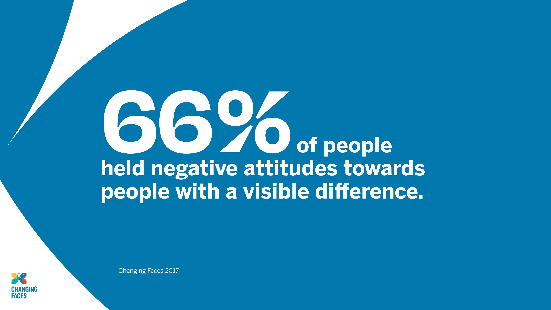

Slide 20

Perceptions of visible difference
There are a number of persistent myths and assumptions, which affect how people with a visible difference are viewed by society, such as not being very clever or being characterised as evil.
Stone (2017) found that people with a visible difference/disfigurement
are viewed much less favourably than people with other disabilities that are easily identified, such as wheelchair users.

Slide 21

When participants in a study compared photos of people with a facial visible difference with those without, they judged them be:
Less out-going
Less competitive
Less assertive
More sensitive and emotional
Followers rather than leaders
Stone (2017)

Slide 22
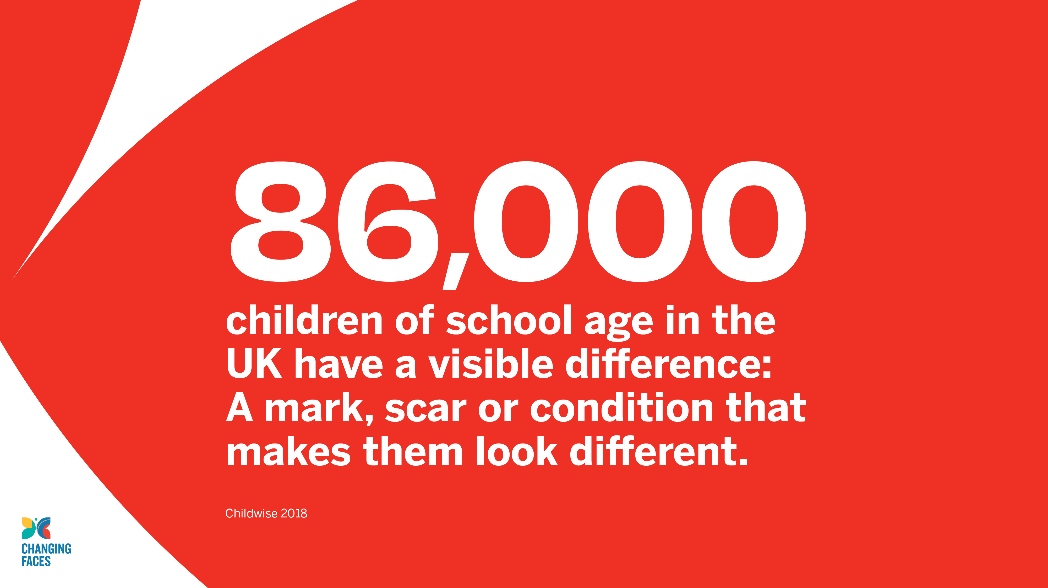

Slide 23

Children’s voices
While watching the video, ask yourself:
When a child has a visible difference, what are the implications to their social inclusion and well-being?
What do you think schools should do to support inclusion of children with a visible difference?

Slide 24
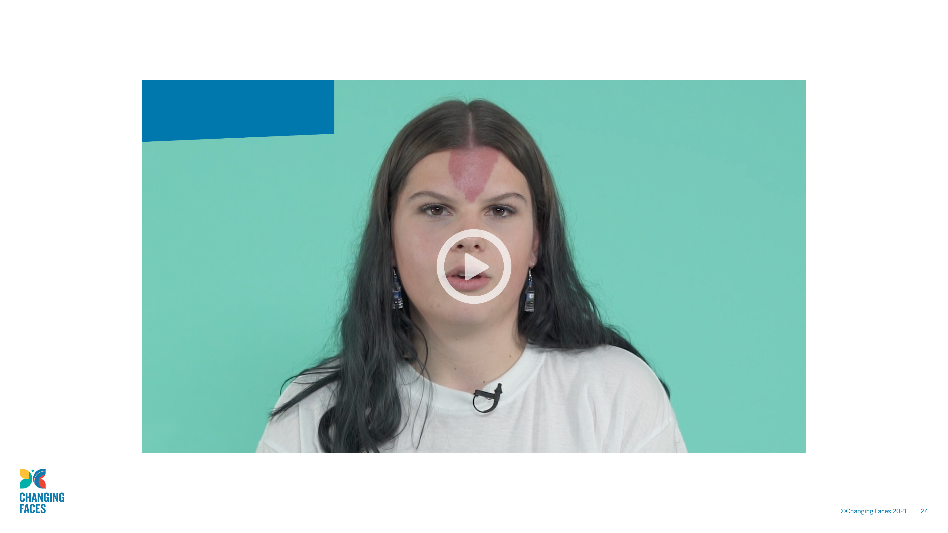
Children and young people’s voices

Slide 25

Parents’ Voices
While watching the video think about:
Whether the children and their parents have different priorities and views.
The challenges that parents face when negotiating with schools and what you think schools could do
to initiate and maintain an honest and open dialogue with parents and their children.

Slide 26
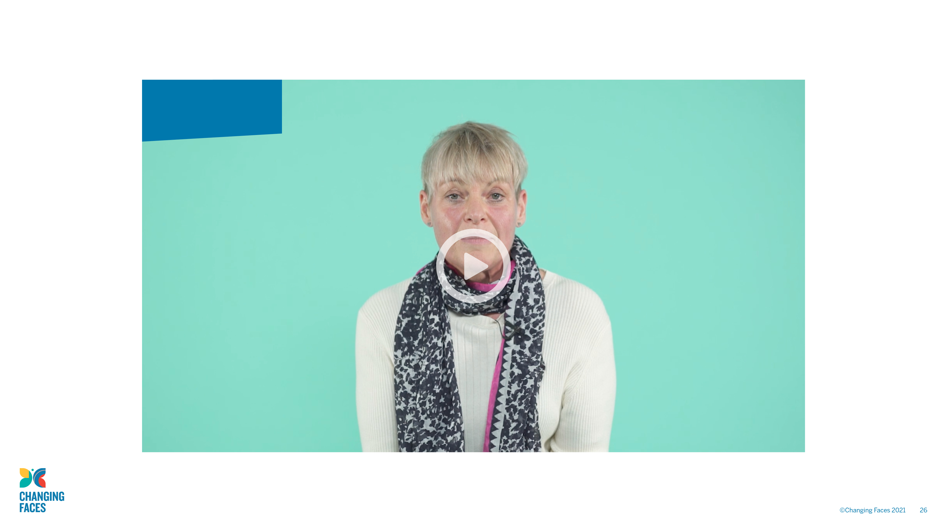
Parents’ voices

Slide 27

GROUP
DISCUSSION
Identify three key points that you will take away from today’s session and make a note of them.

Slide 28

Taking this forward
When you are in school, keep a record of how having a better understanding of the impact of difference and unconscious (implicit) bias has influenced your practice.
In our next session, you will have a chance to discuss your experiences and have a look at some resources you can use with your students.

Slide 29

Face
BY HANNAH LINDFIELD
See past the scars, I can laugh and smile too See past the disability, I have a brain too
Do you really care
Or is that a hard question to ask?
With each stare or with each comment You will always open old wounds
If you see me wobble, or if I stutter
Will you help me or will you let me suffer?
After reading this poem, I hope you know
Why normal is a place where I have no wish to go!

